Slide 1
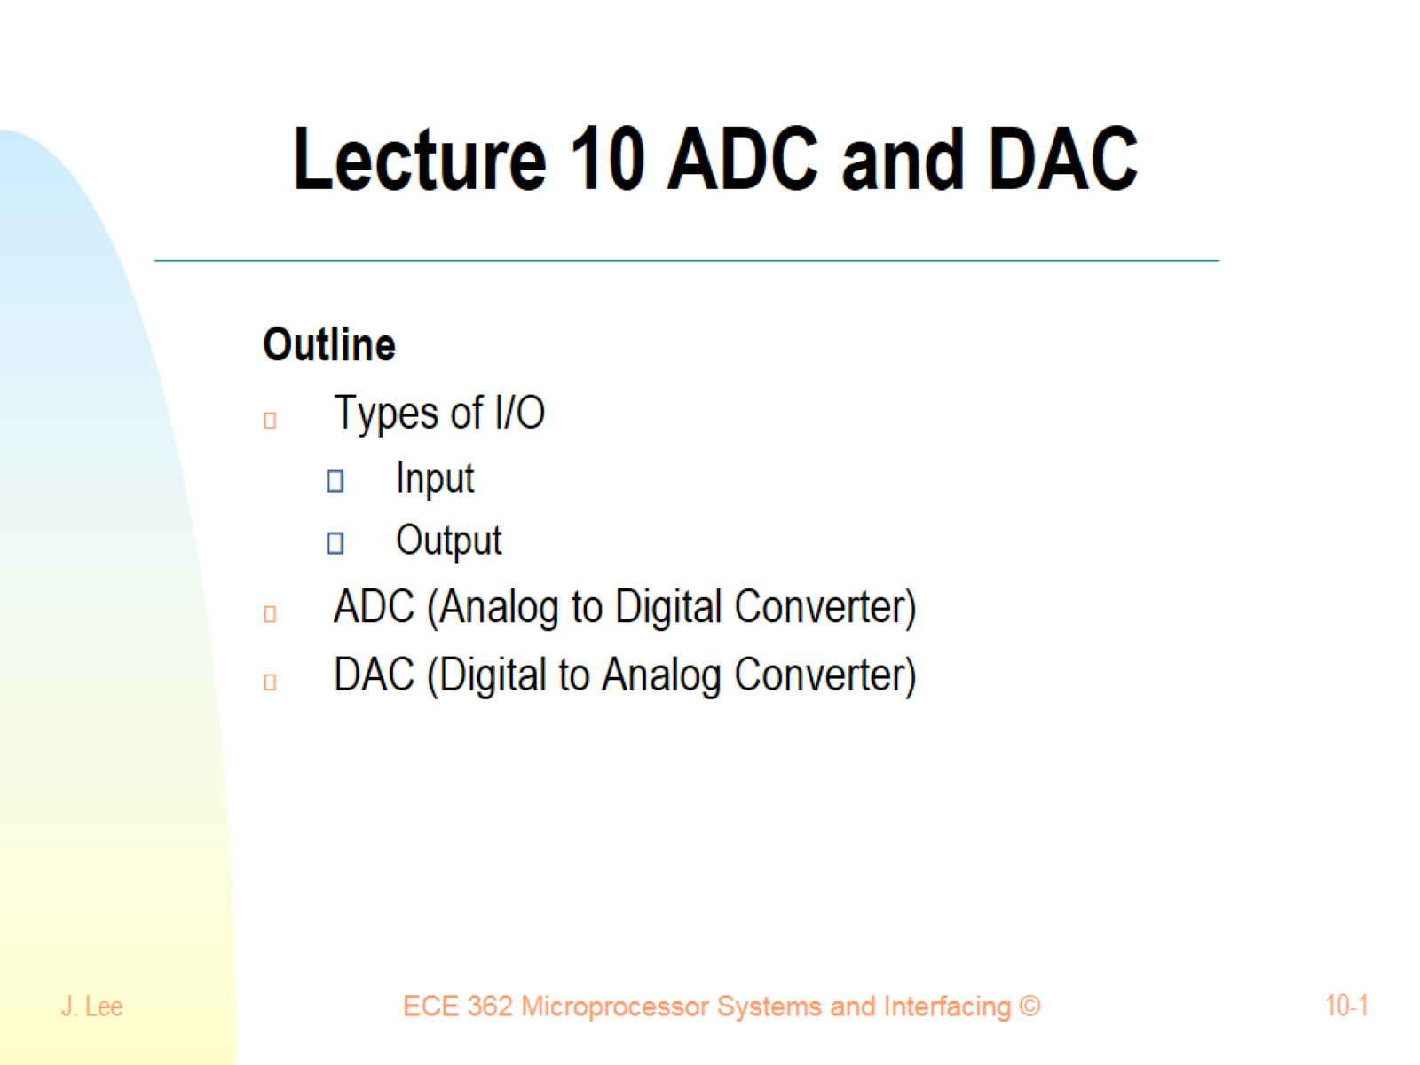
Lecture 10 ADC and DAC

Slide 2
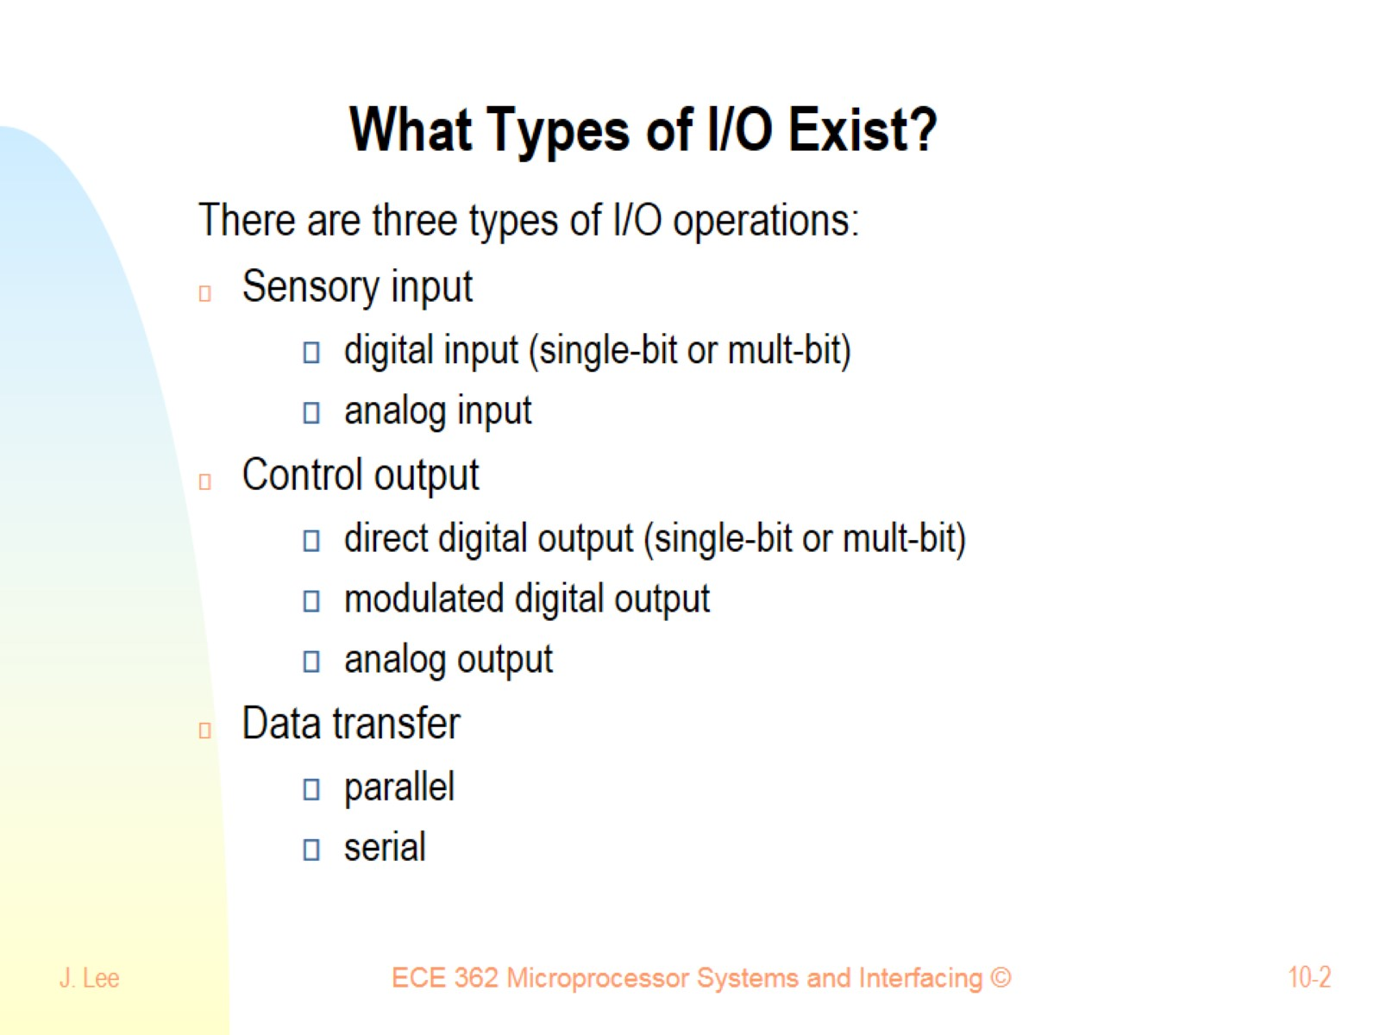
What Types of I/O Exist?

Slide 3
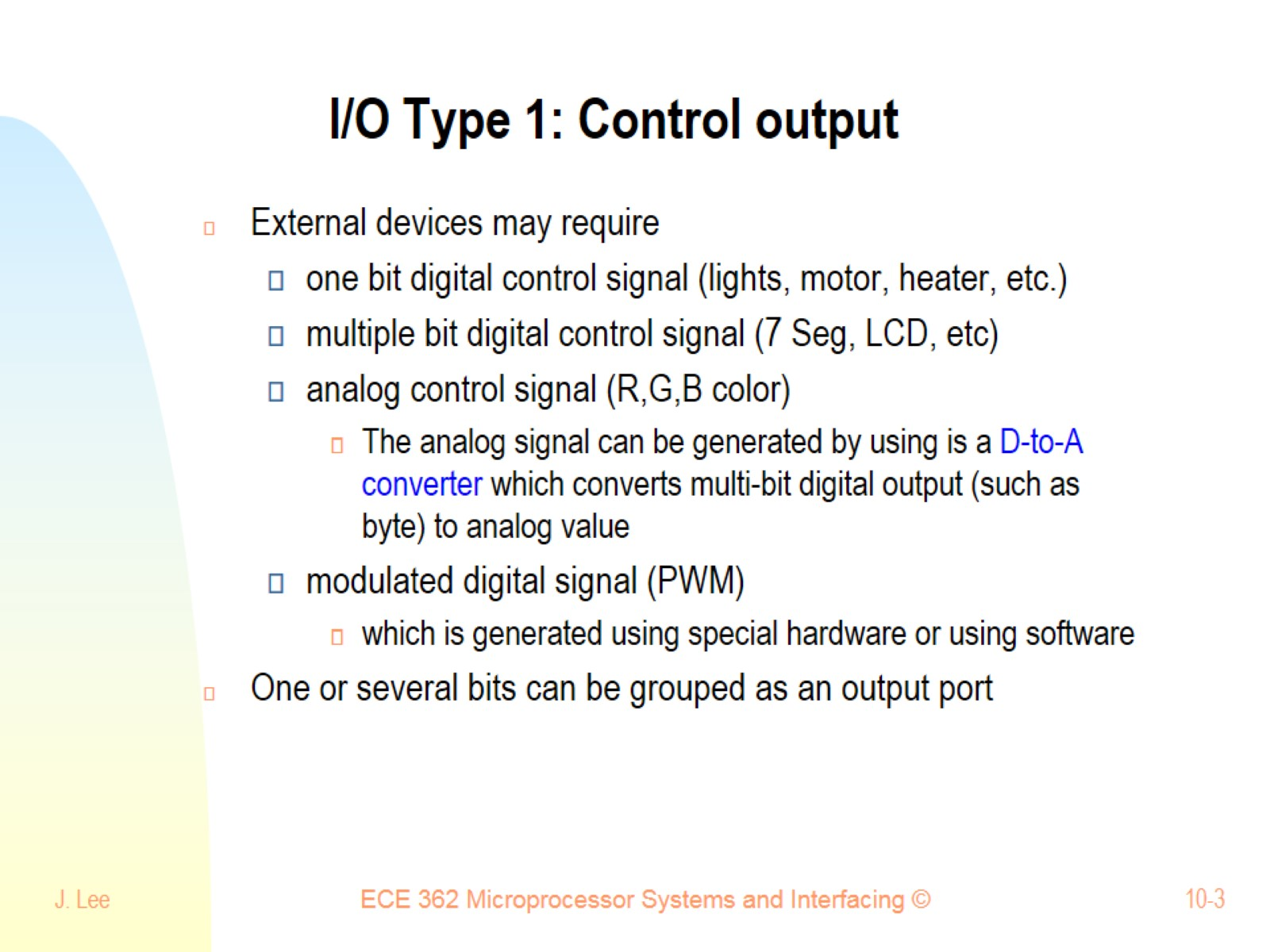
I/O Type 1: Control output

Slide 4
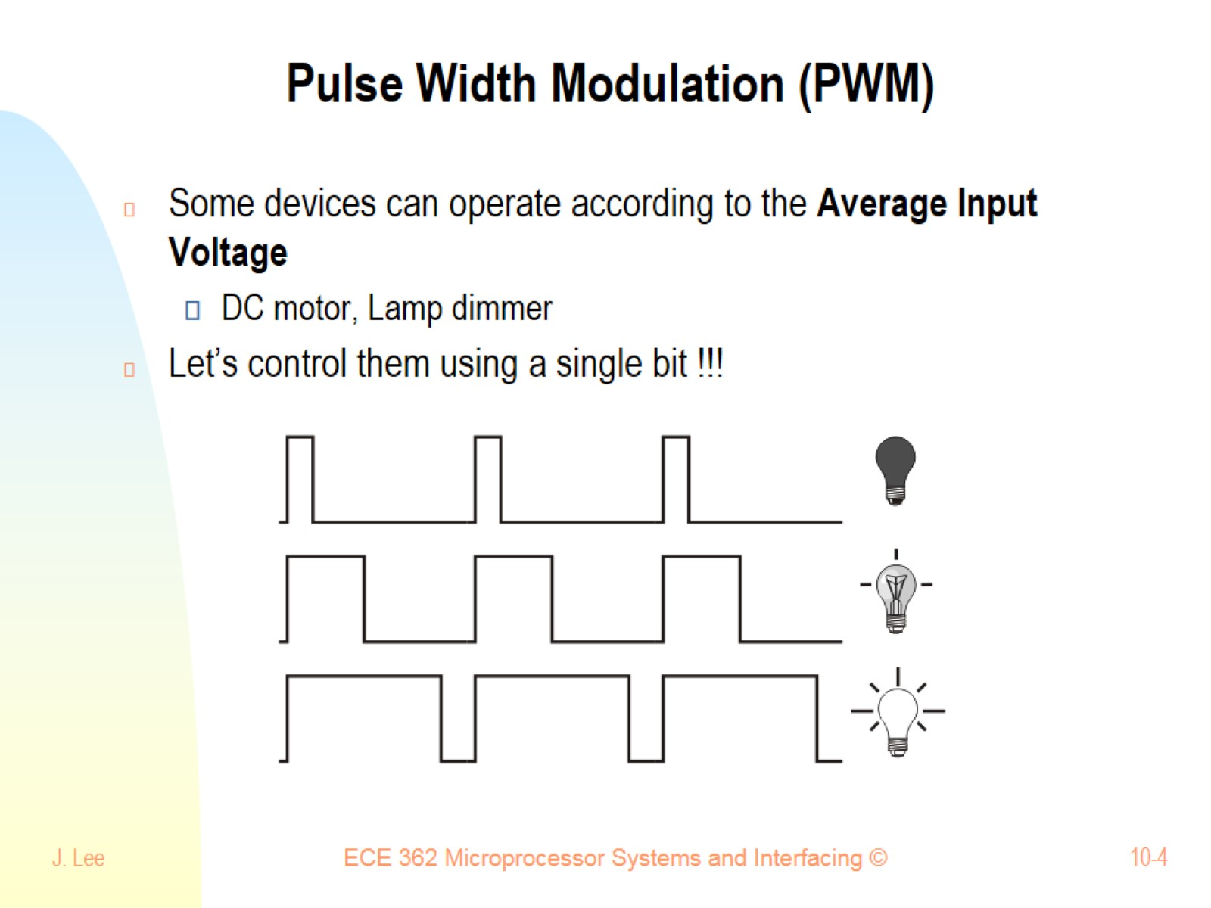
Pulse Width Modulation (PWM)

Slide 5
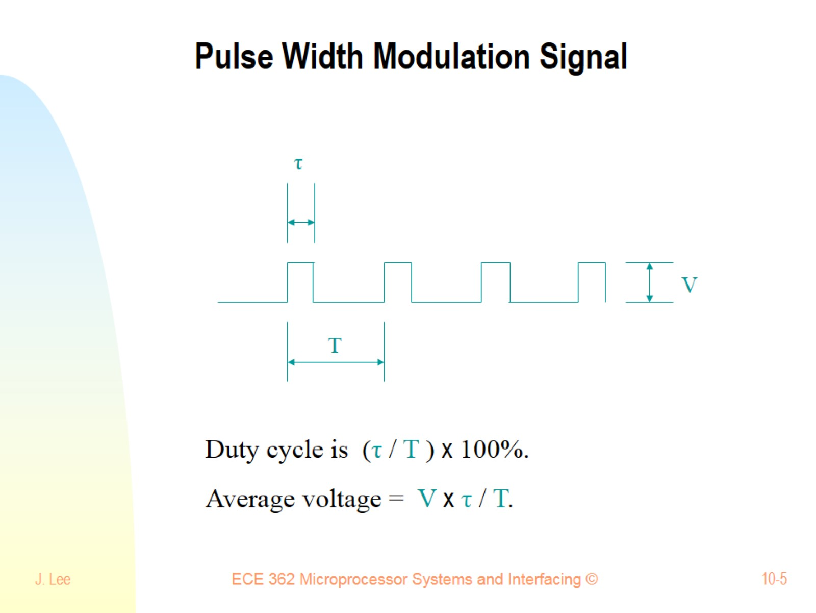
Pulse Width Modulation Signal

Slide 6
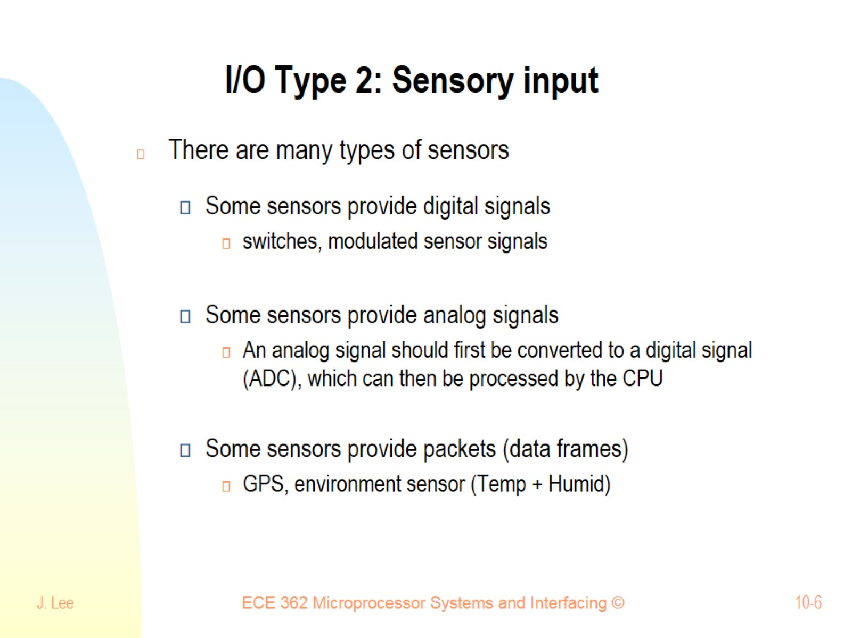
I/O Type 2: Sensory input

Slide 7
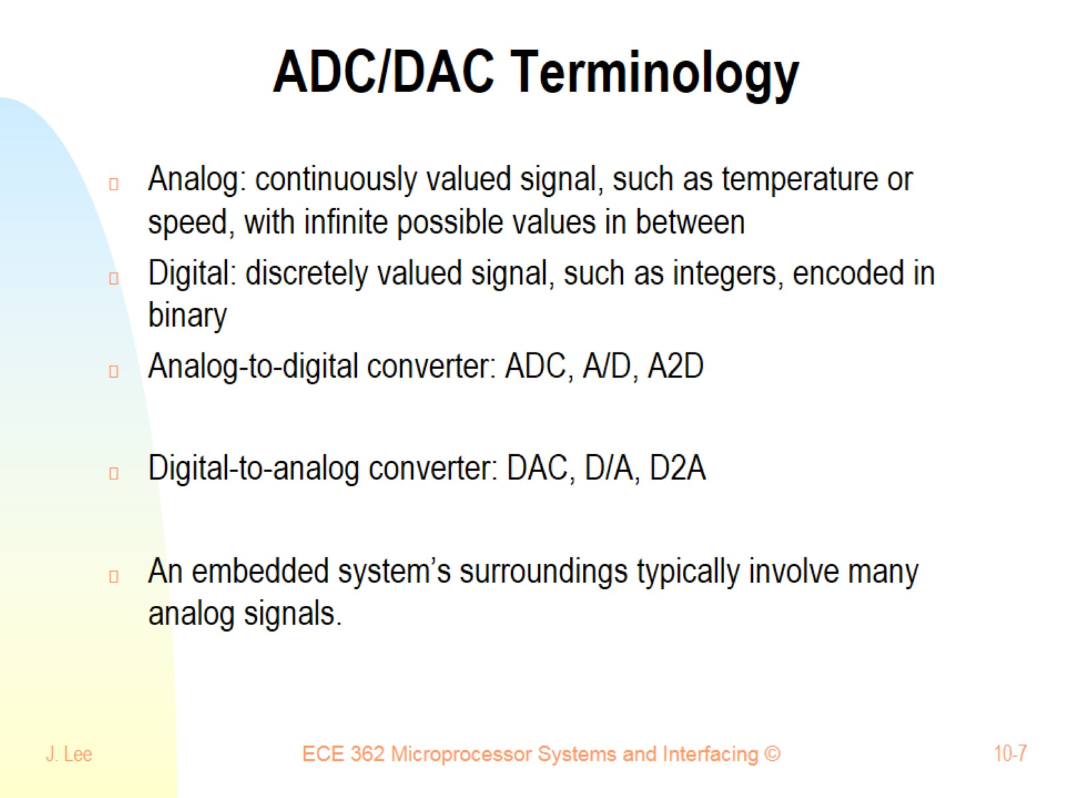
ADC/DAC Terminology

Slide 8
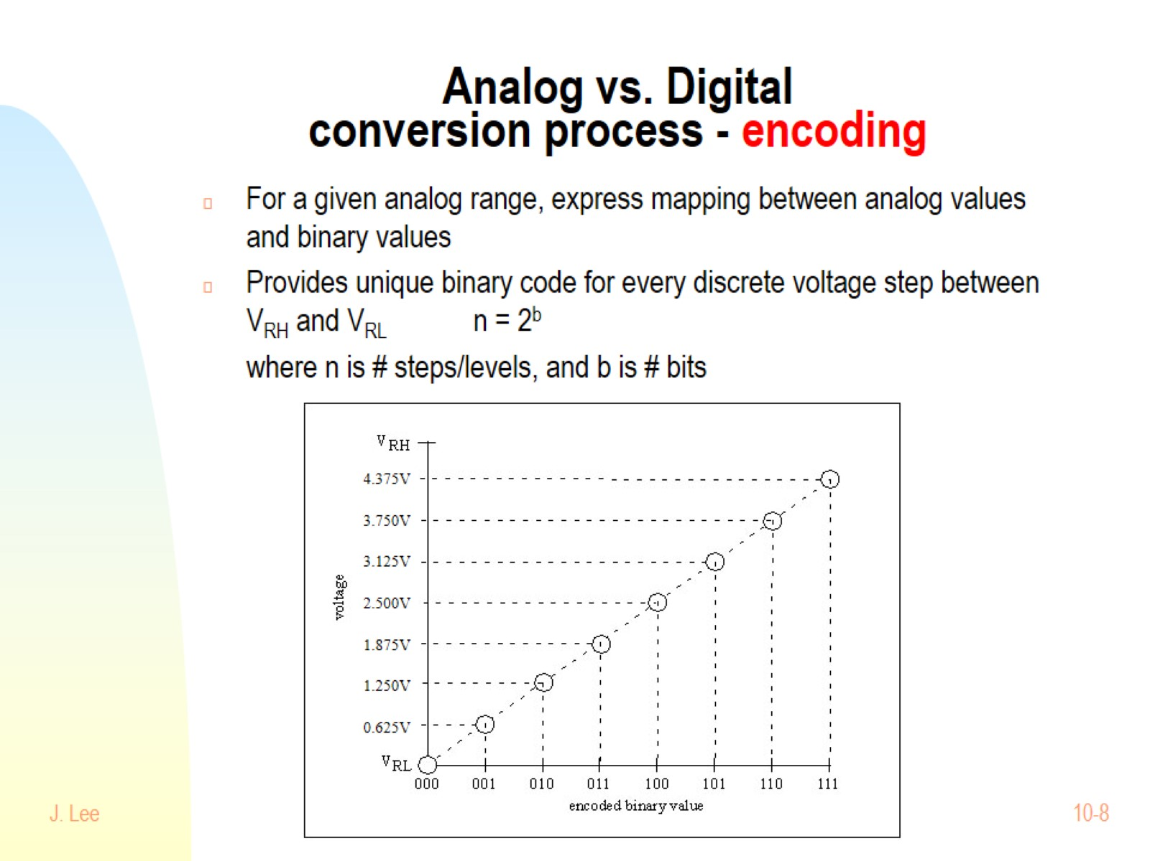
Analog vs. Digital conversion process - encoding

Slide 9
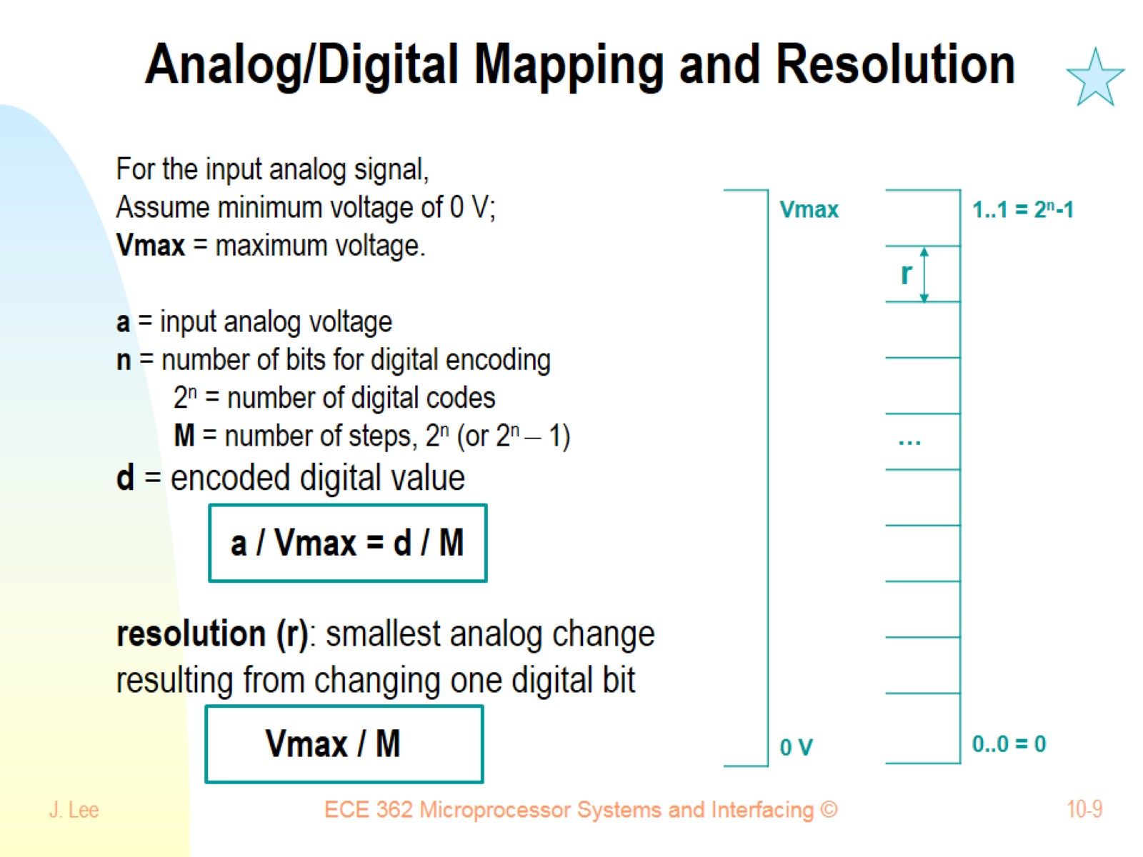
Analog/Digital Mapping and Resolution

Slide 10
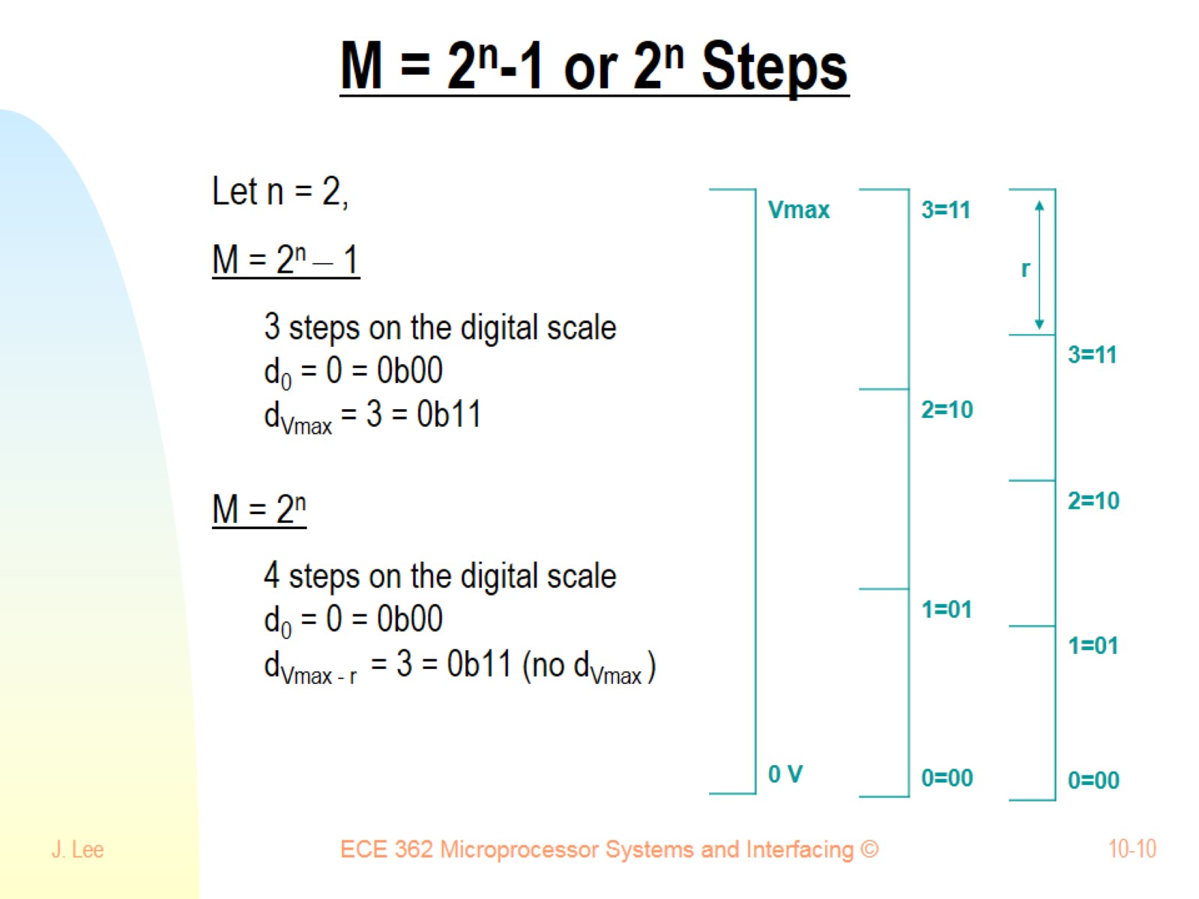
M = 2^{n}-1 or 2^{n} Steps

Slide 11
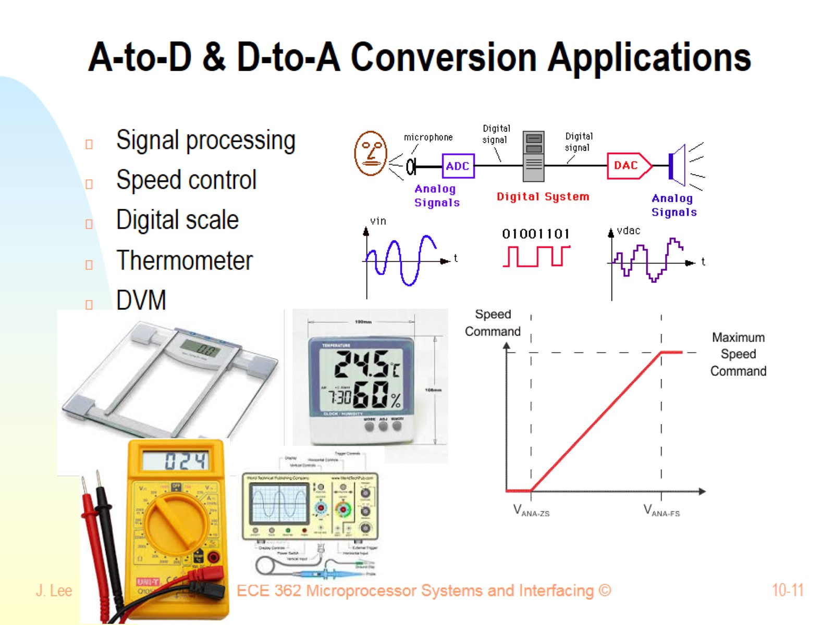
A-to-D & D-to-A Conversion Applications

Slide 12
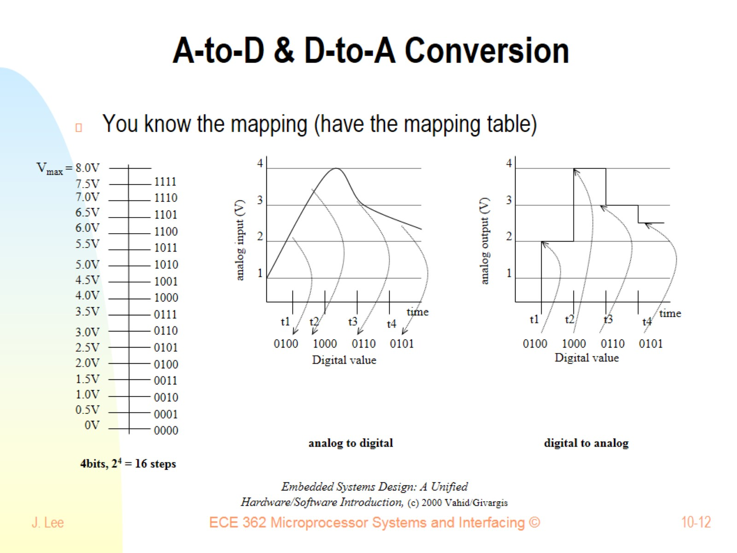
A-to-D & D-to-A Conversion

Slide 13
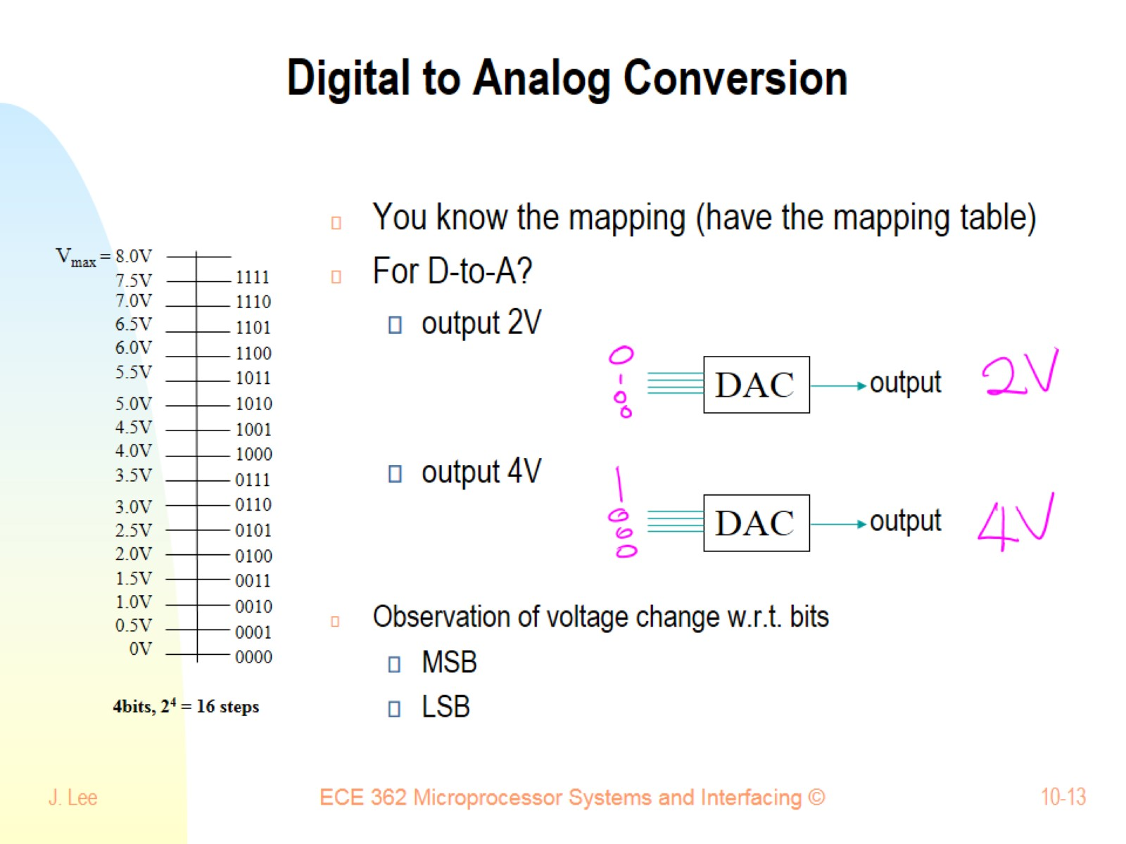
Digital to Analog Conversion

Slide 14
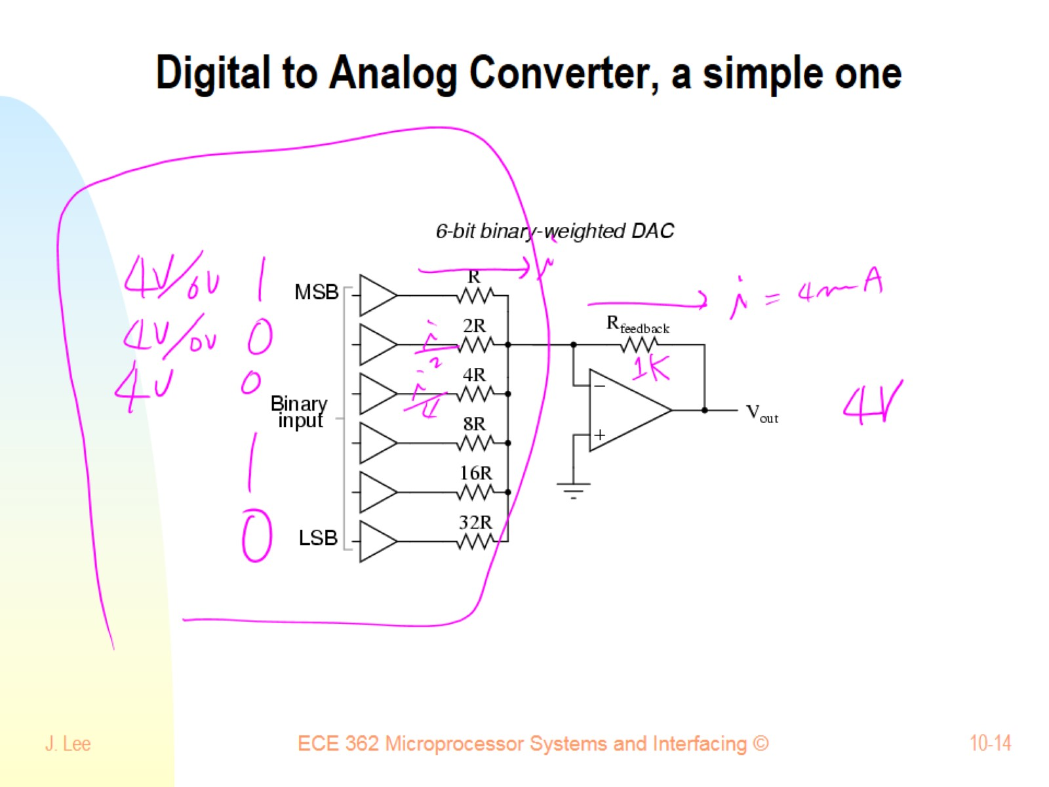
Digital to Analog Converter, a simple one

Slide 15
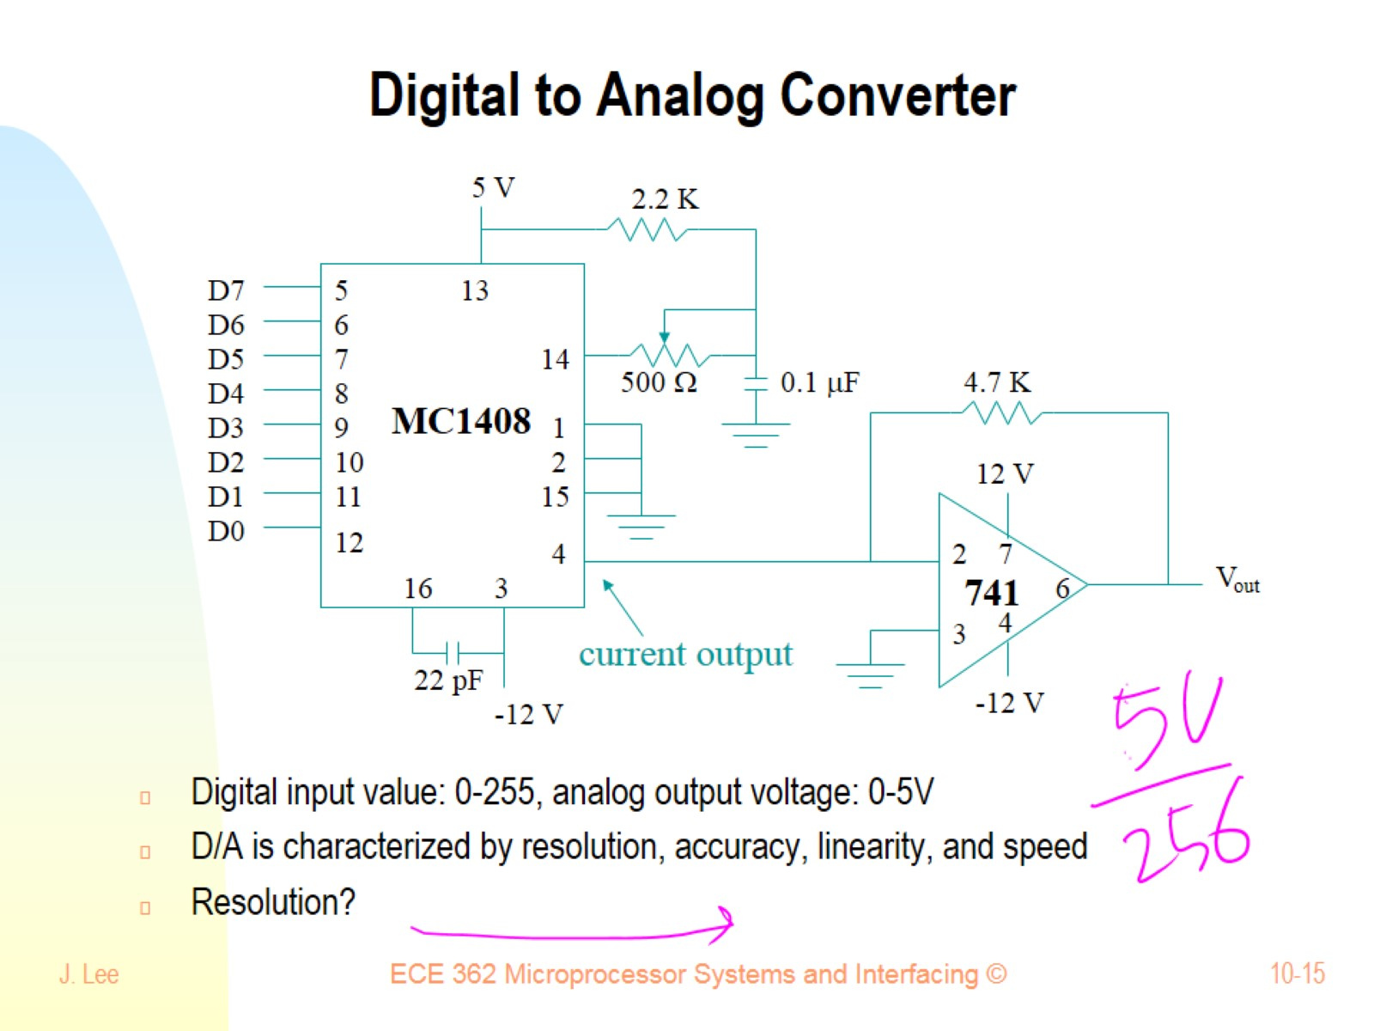
Digital to Analog Converter

Slide 16
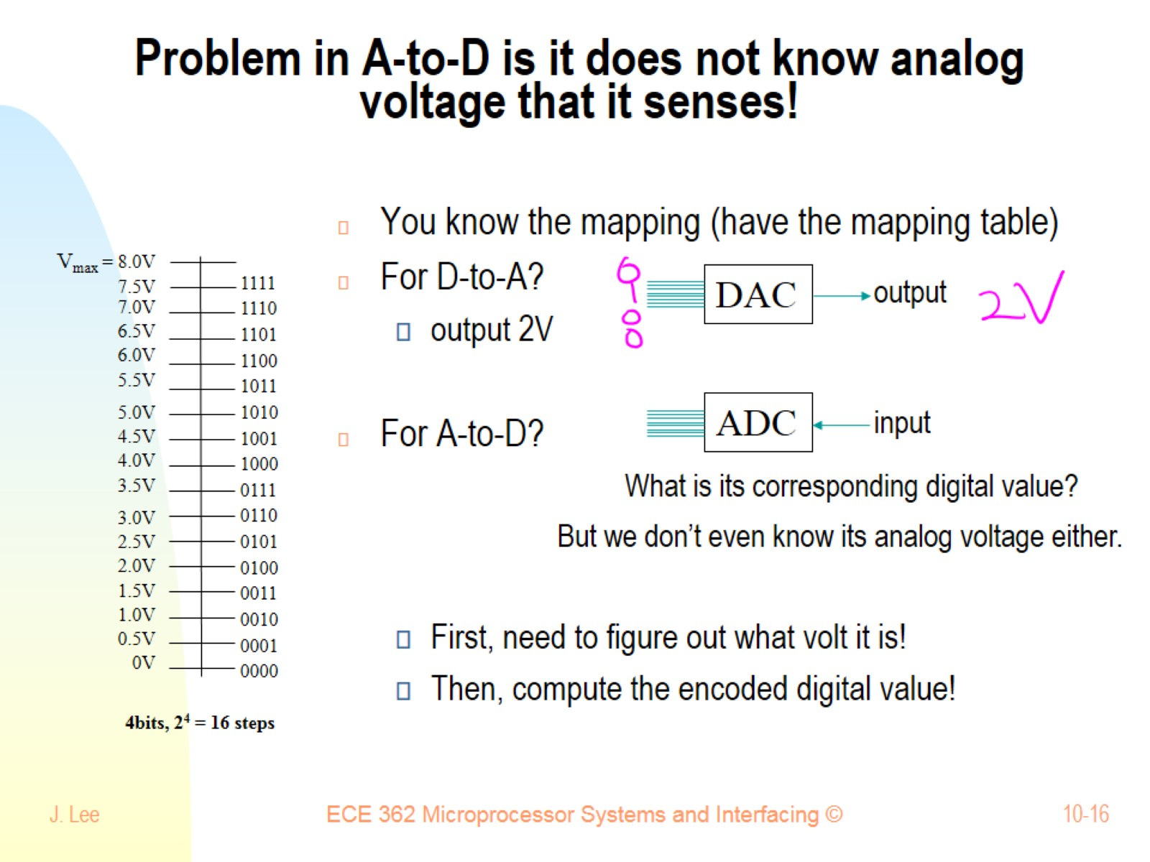
Problem in A-to-D is it does not know analog voltage that it senses!

Slide 17
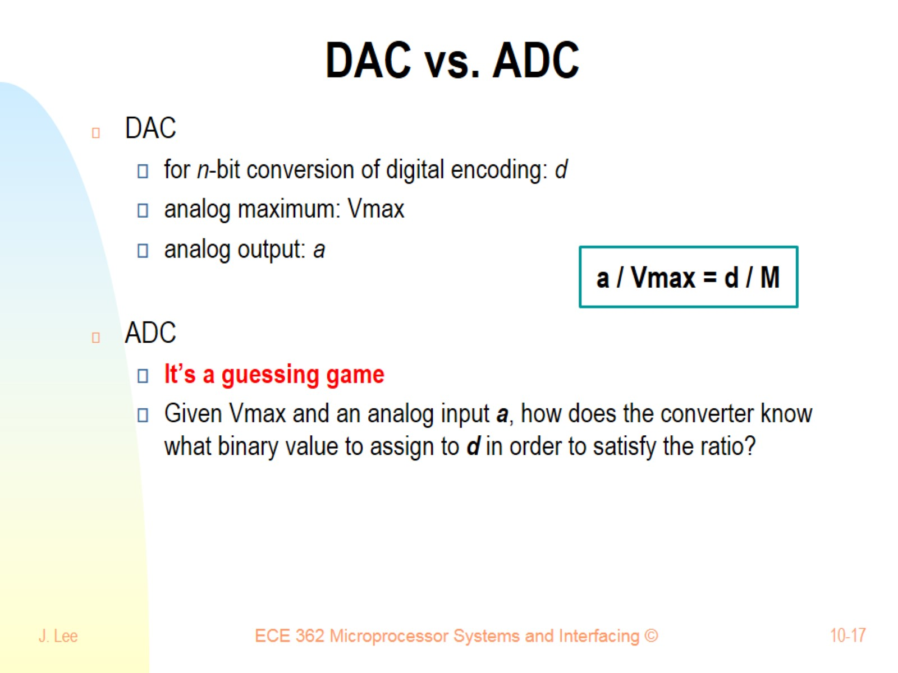
DAC vs. ADC

Slide 18
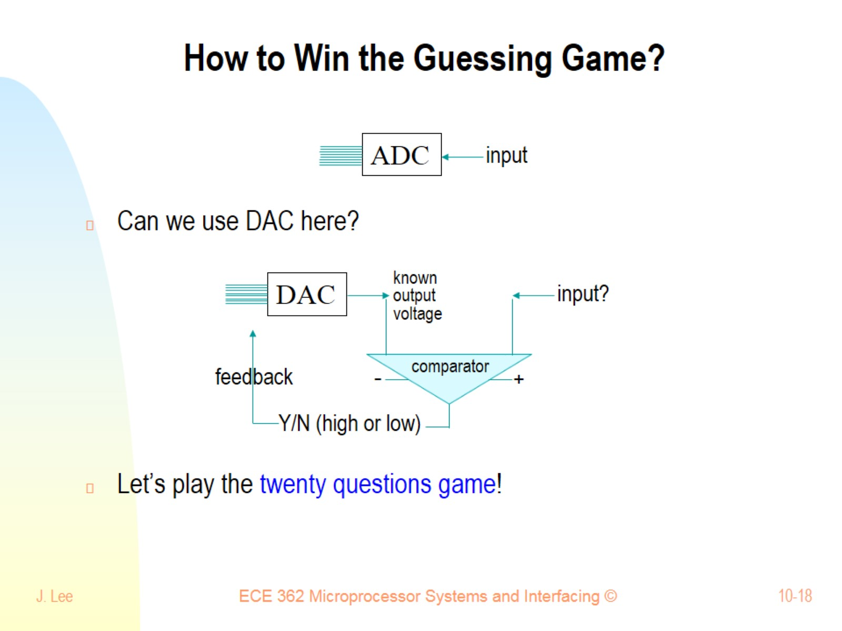
How to Win the Guessing Game?

Slide 19
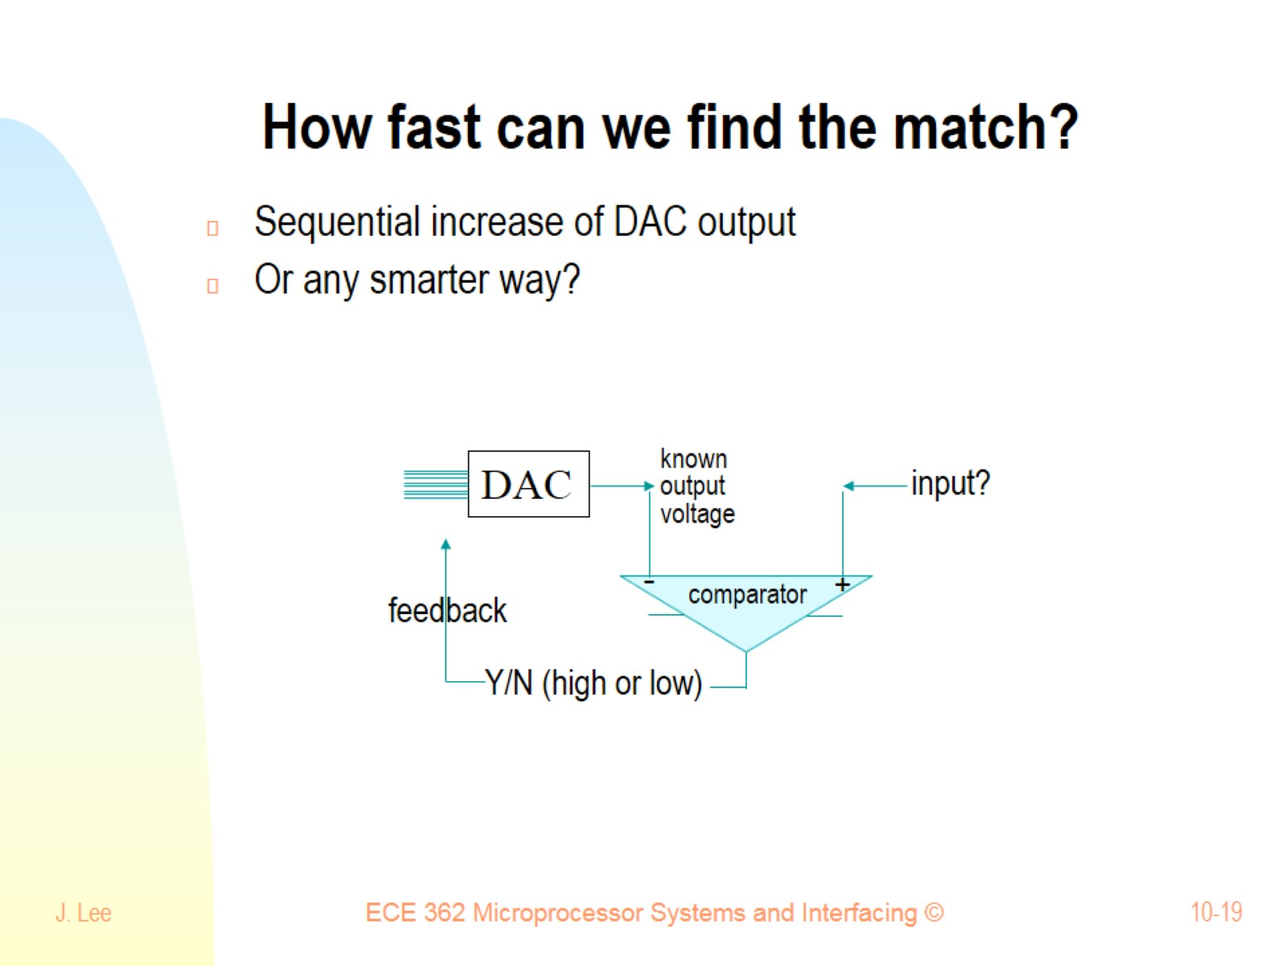
How fast can we find the match?

Slide 20
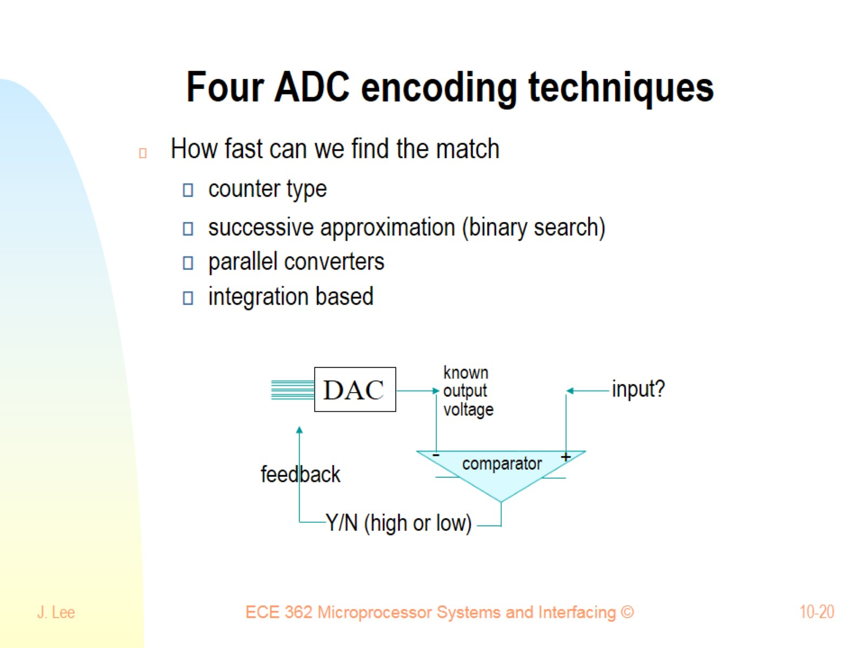
Four ADC encoding techniques

Slide 21
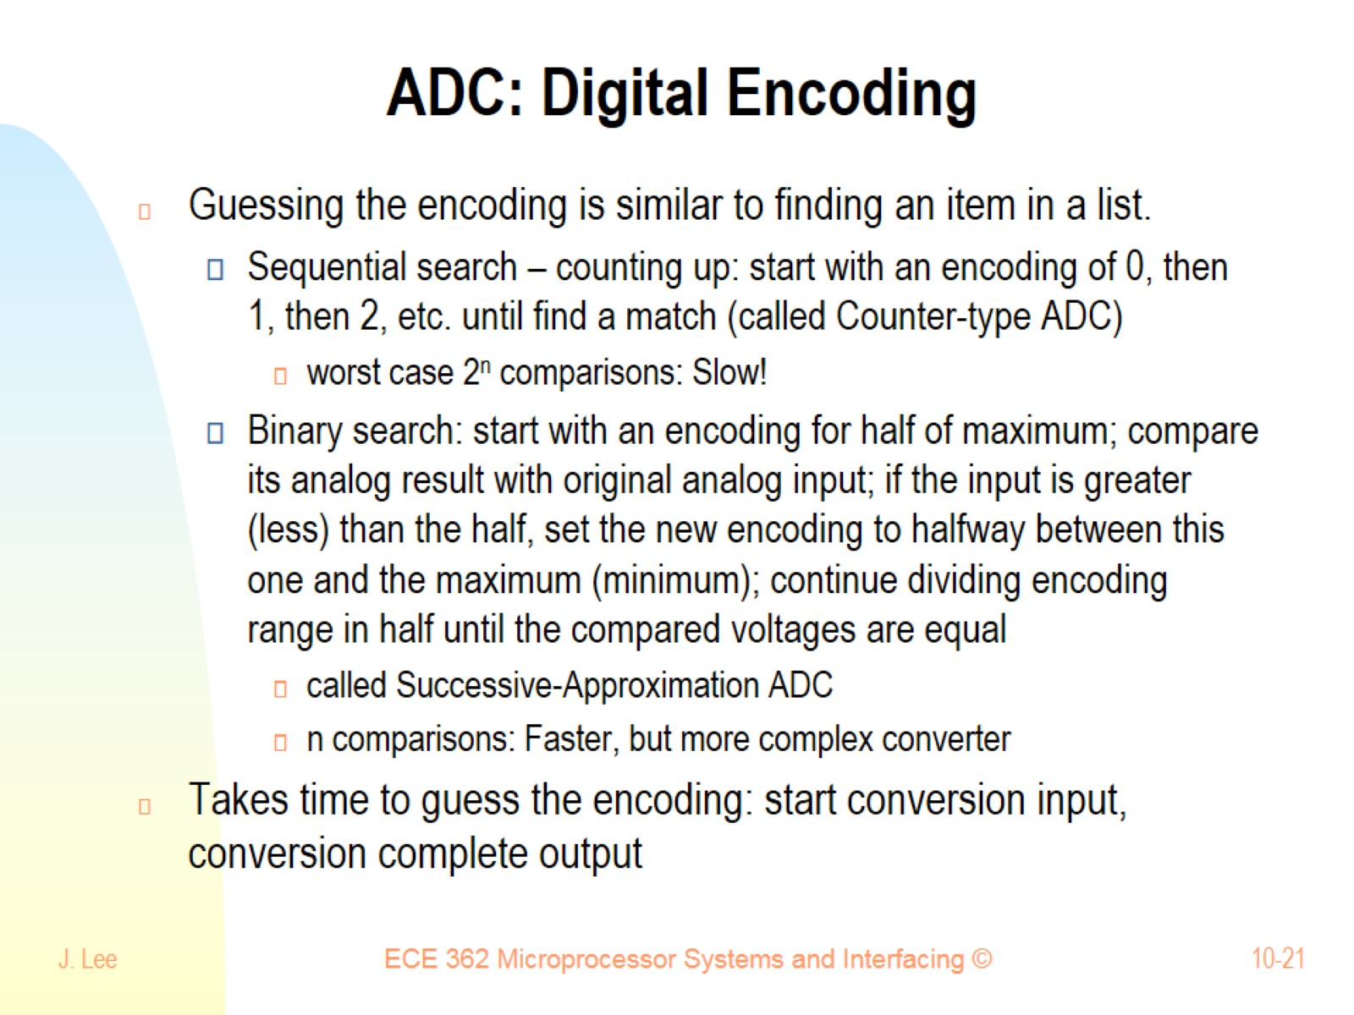
ADC: Digital Encoding

Slide 22
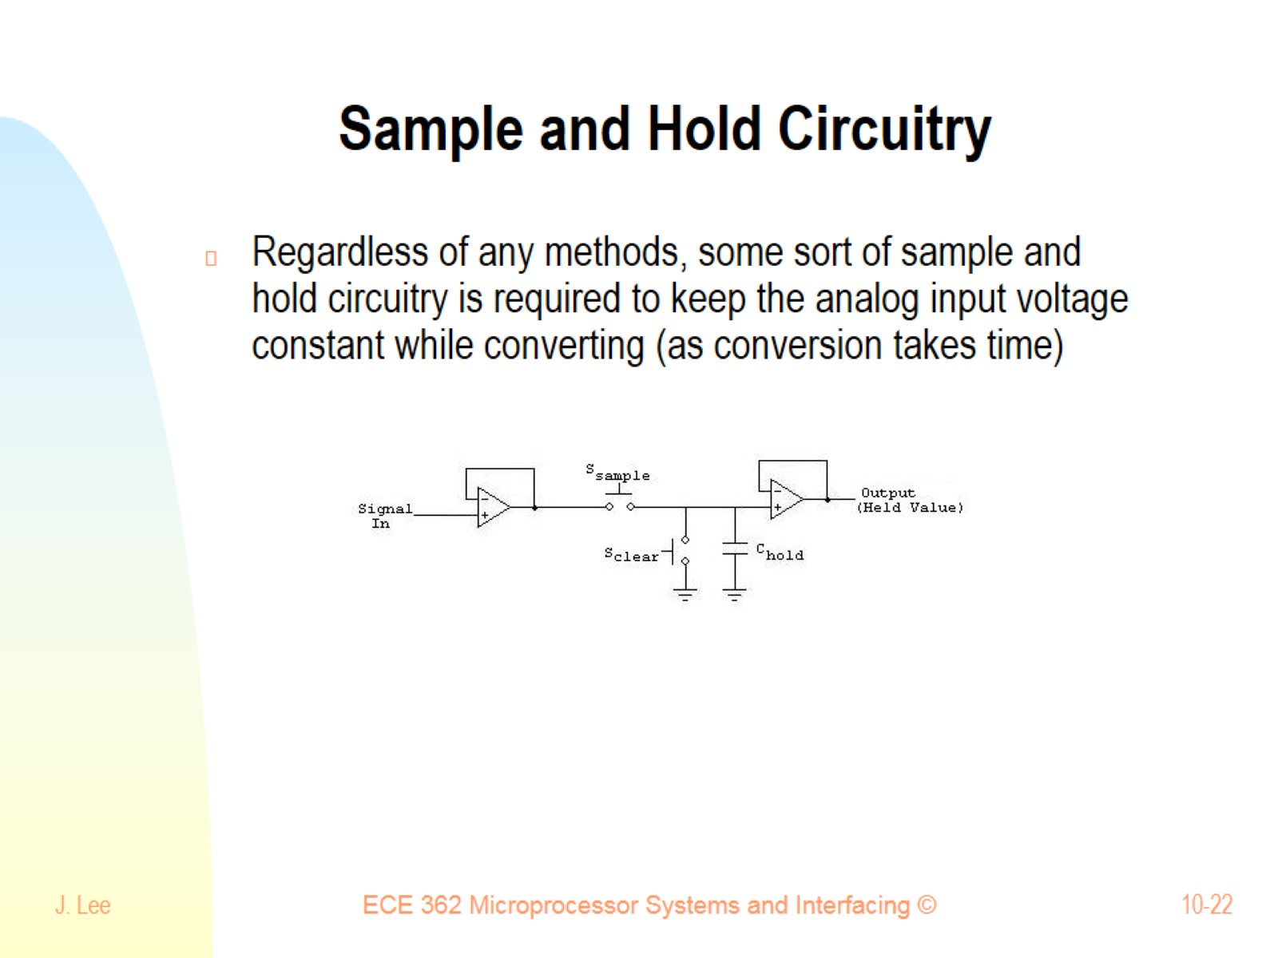
Sample and Hold Circuitry

Slide 23
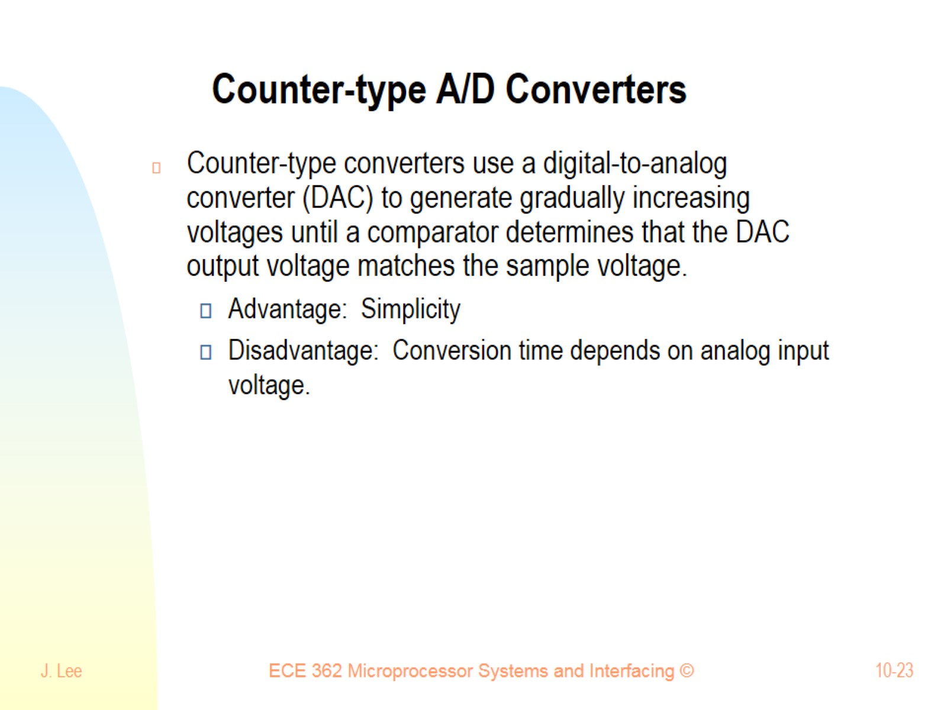
Counter-type A/D Converters

Slide 24
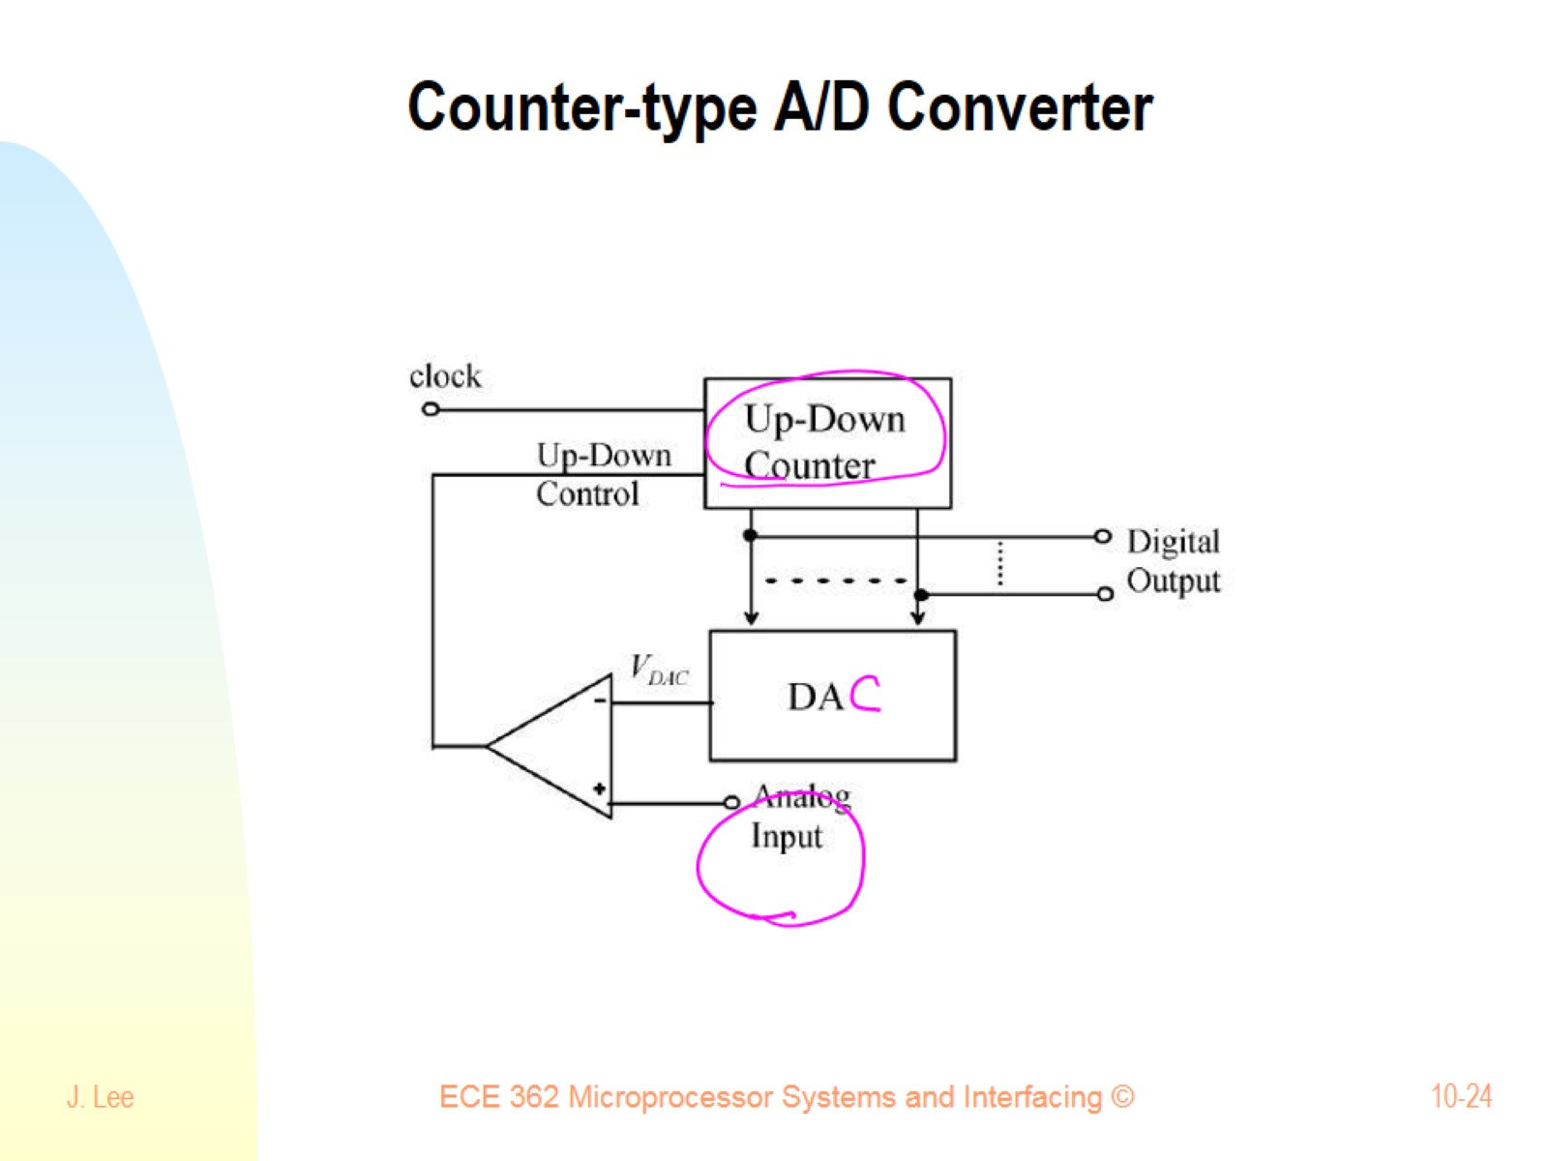
Counter-type A/D Converter

Slide 25
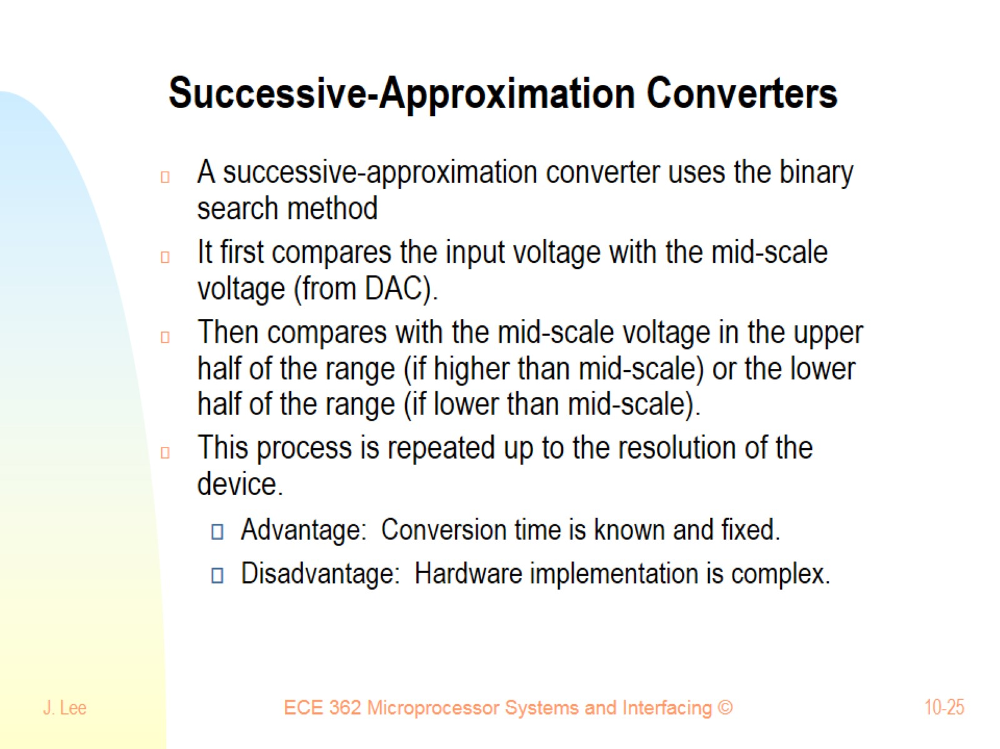
Successive-Approximation Converters

Slide 26
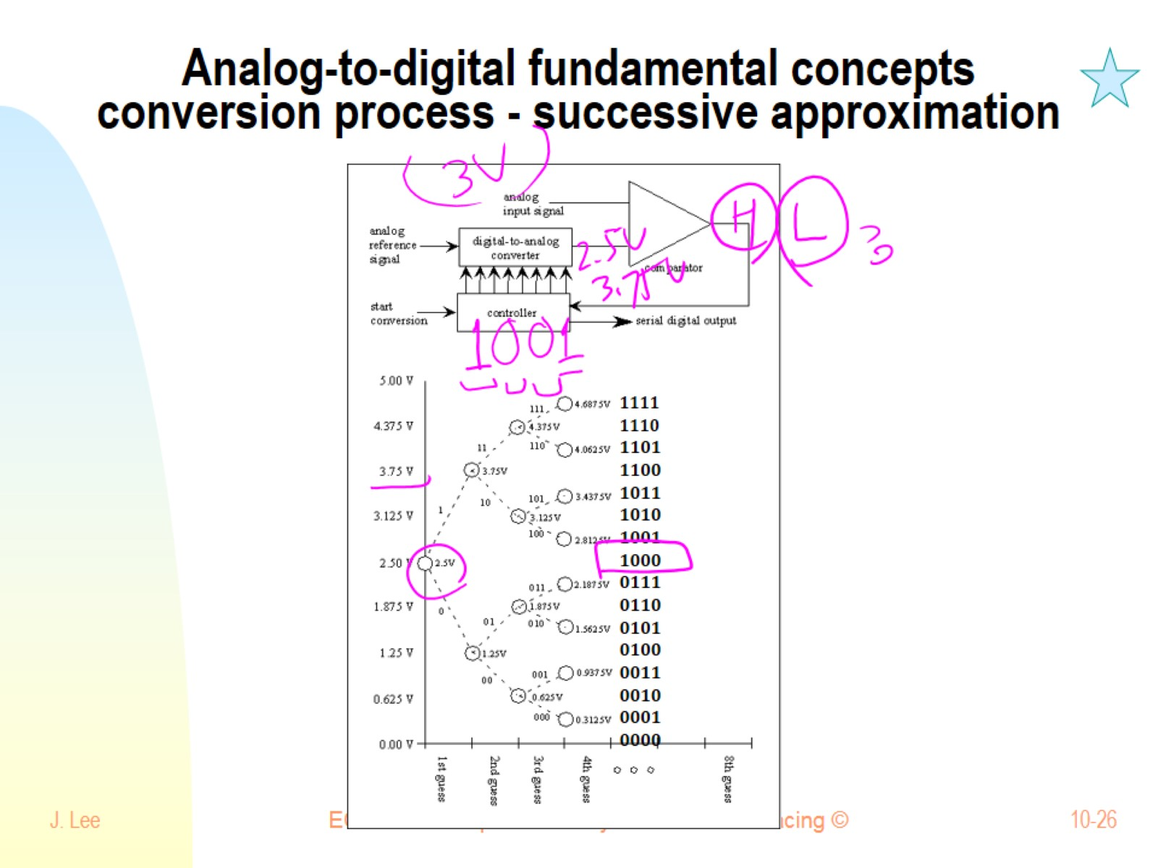
Analog-to-digital fundamental concepts conversion process - successive approximation

Slide 27
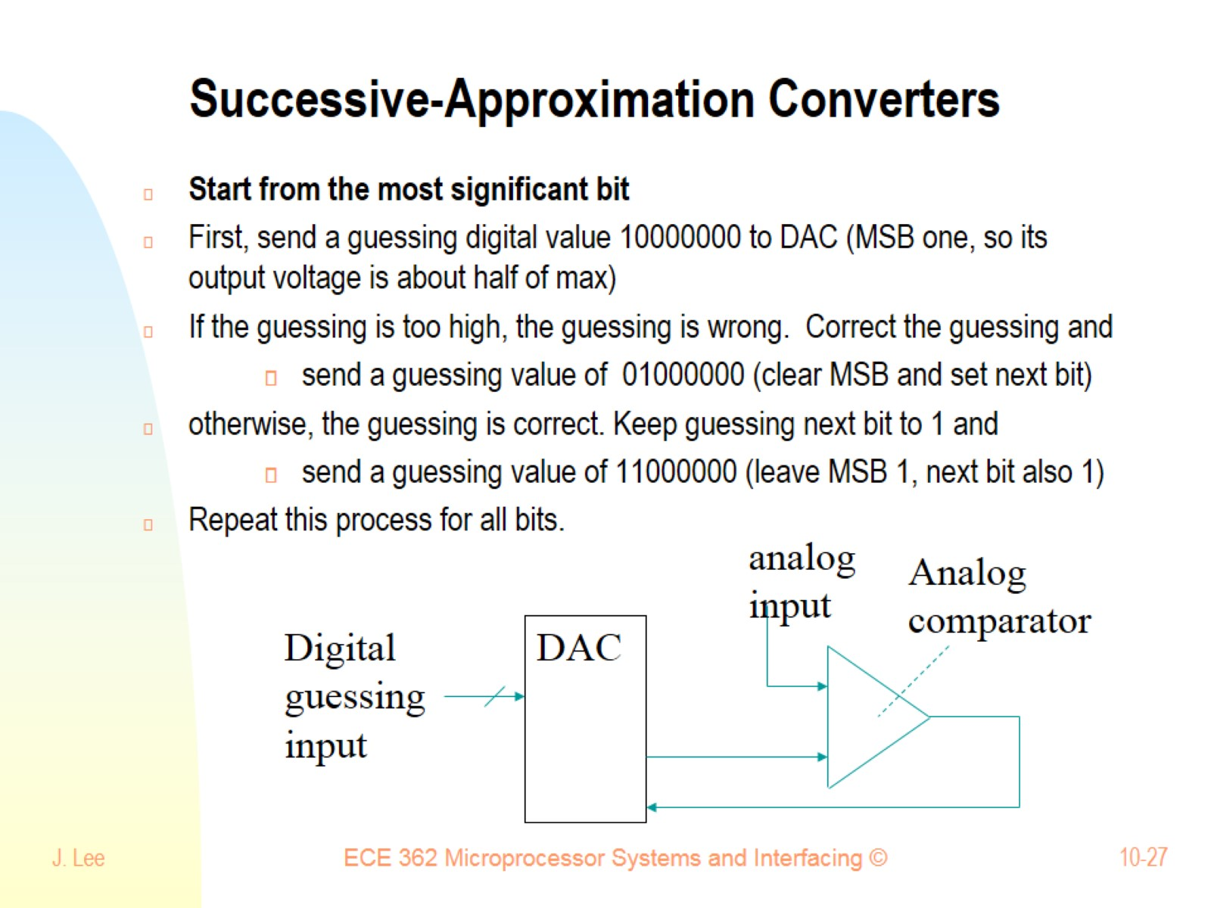
Successive-Approximation Converters

Slide 28
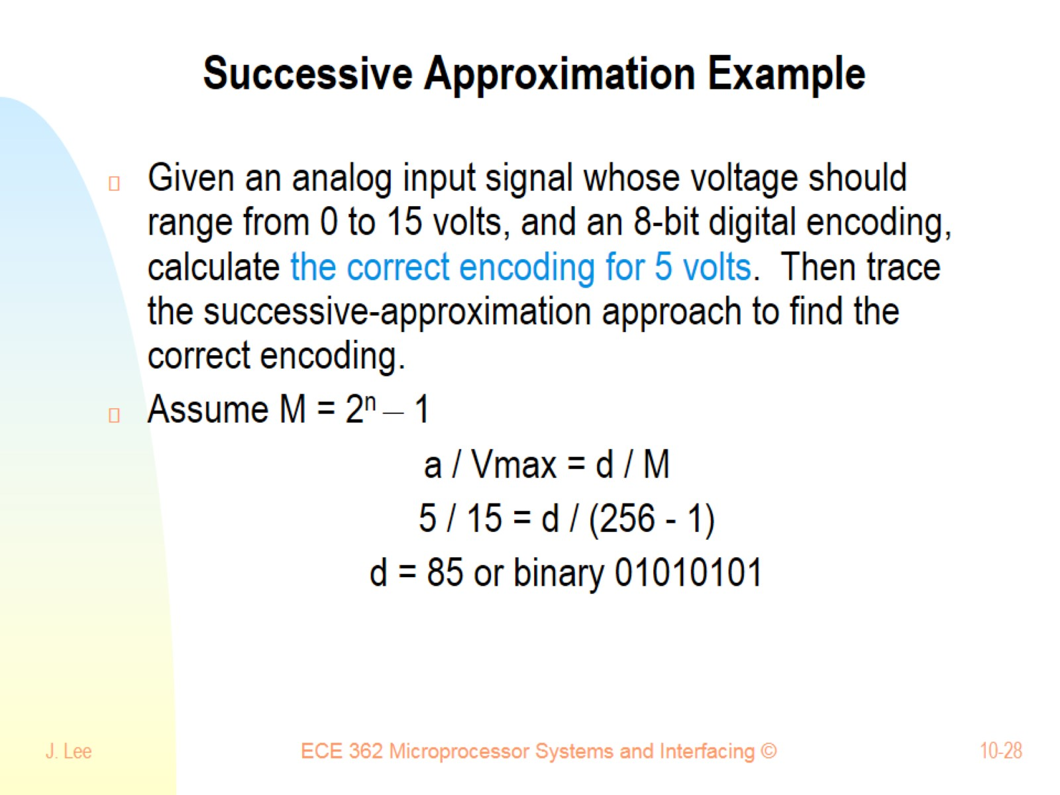
Successive Approximation Example

Slide 29
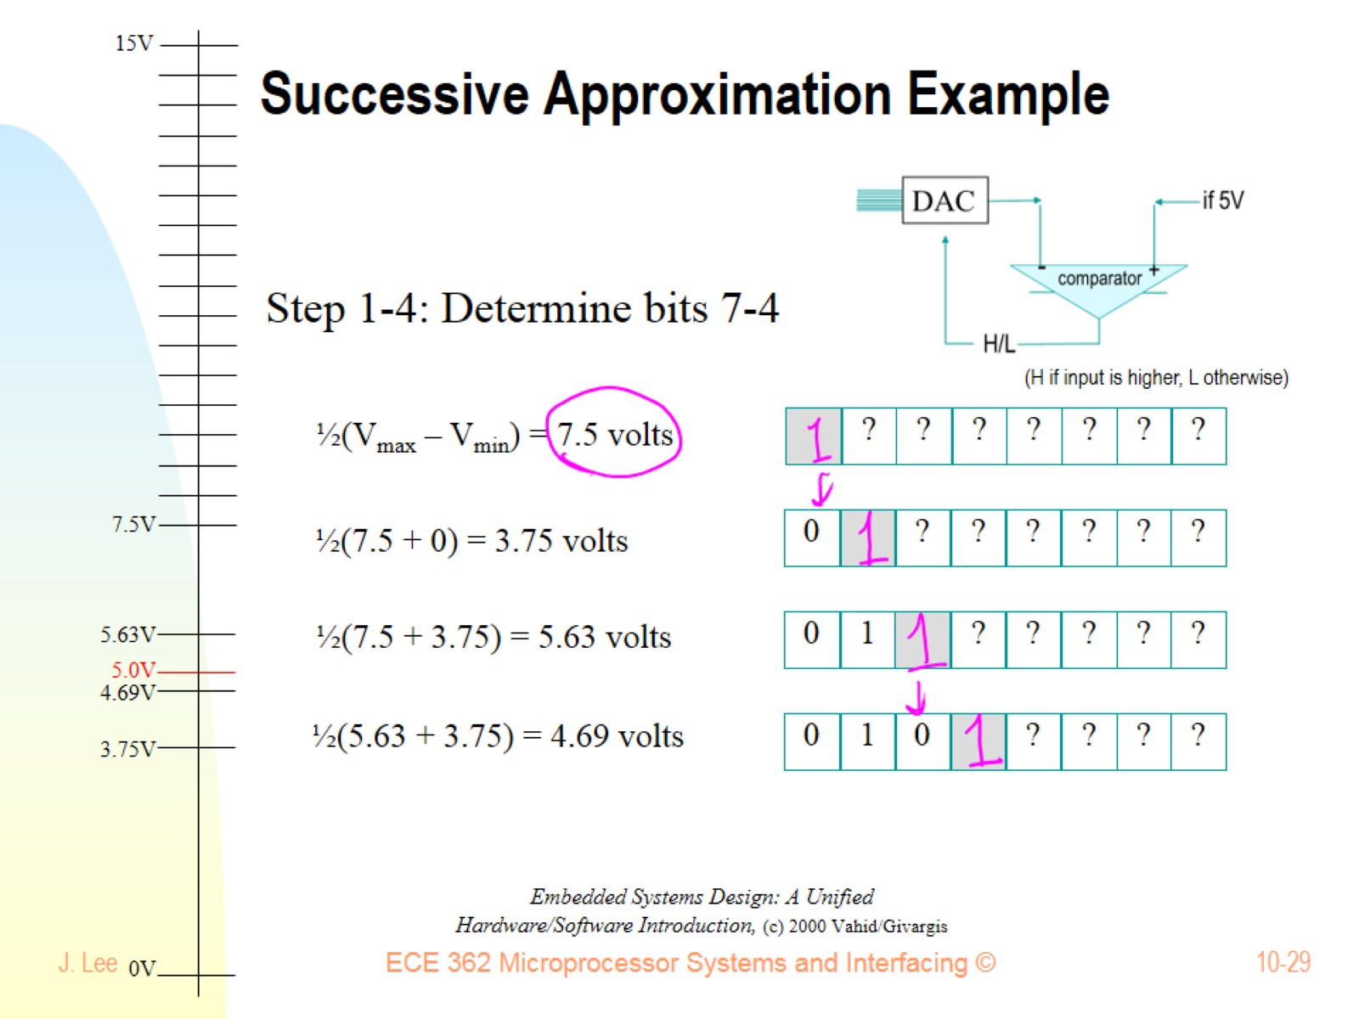
Successive Approximation Example

Slide 30
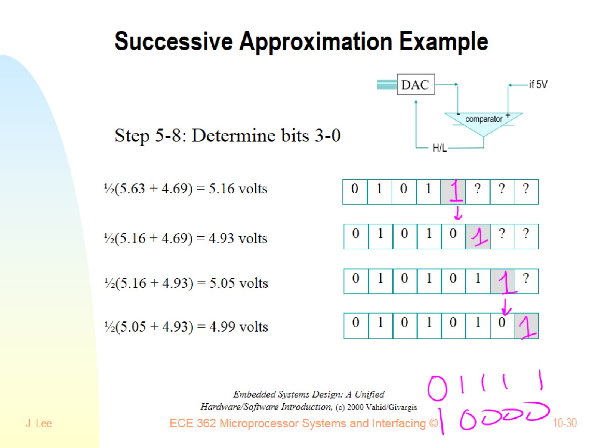
Successive Approximation Example

Slide 31
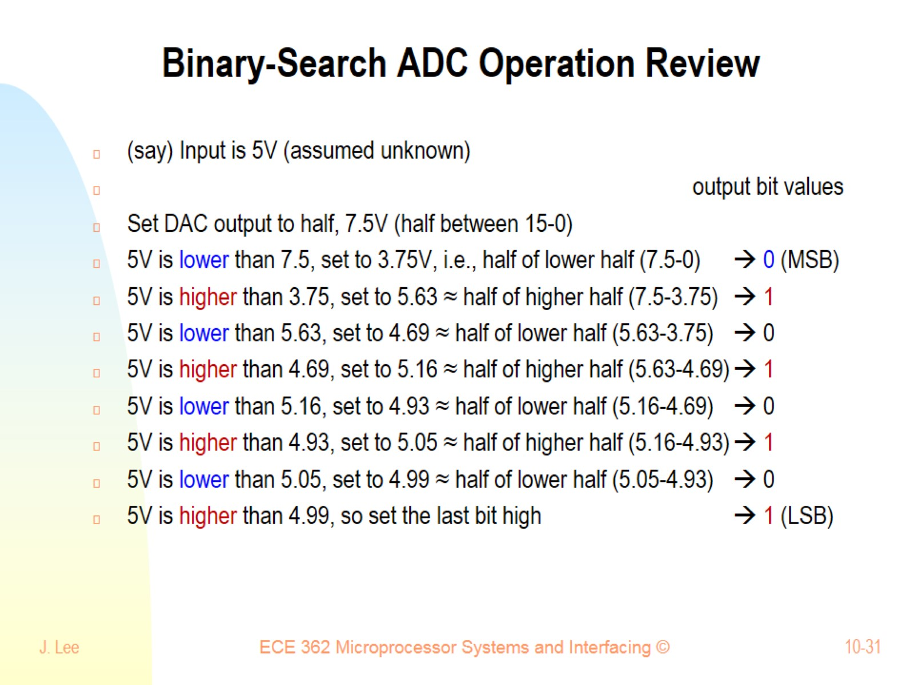
Binary-Search ADC Operation Review

Slide 32
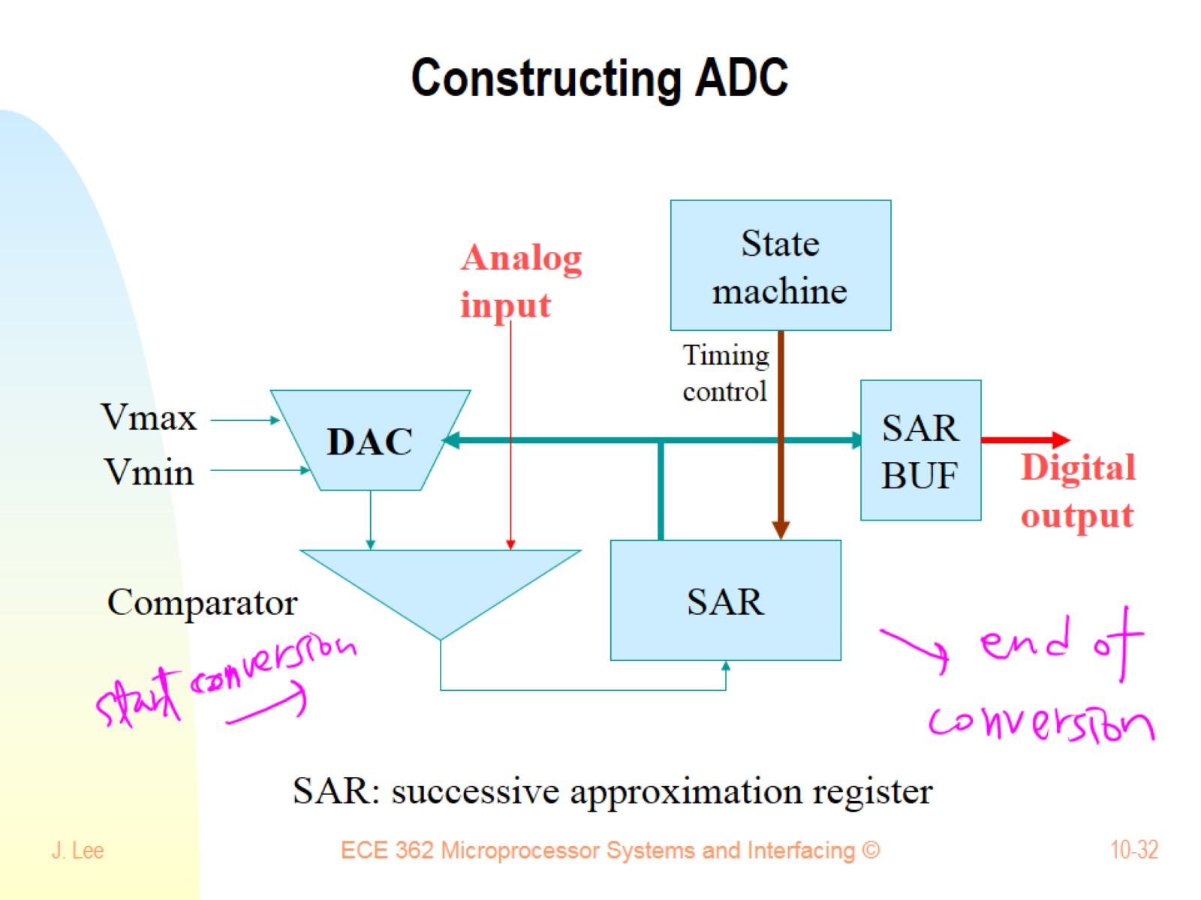
Constructing ADC

Slide 33
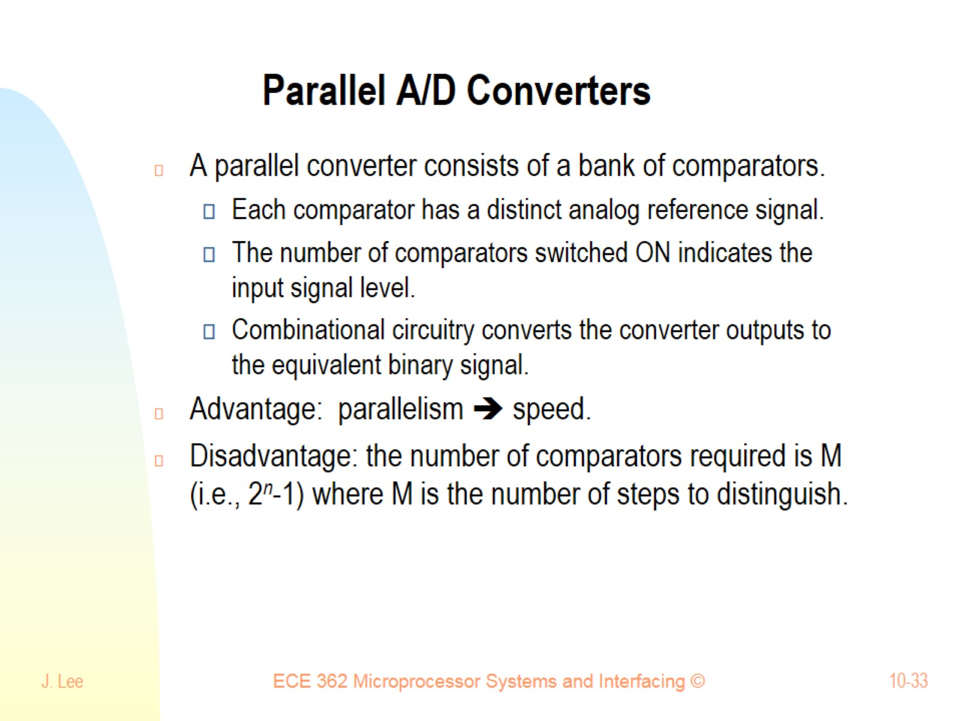
Parallel A/D Converters

Slide 34
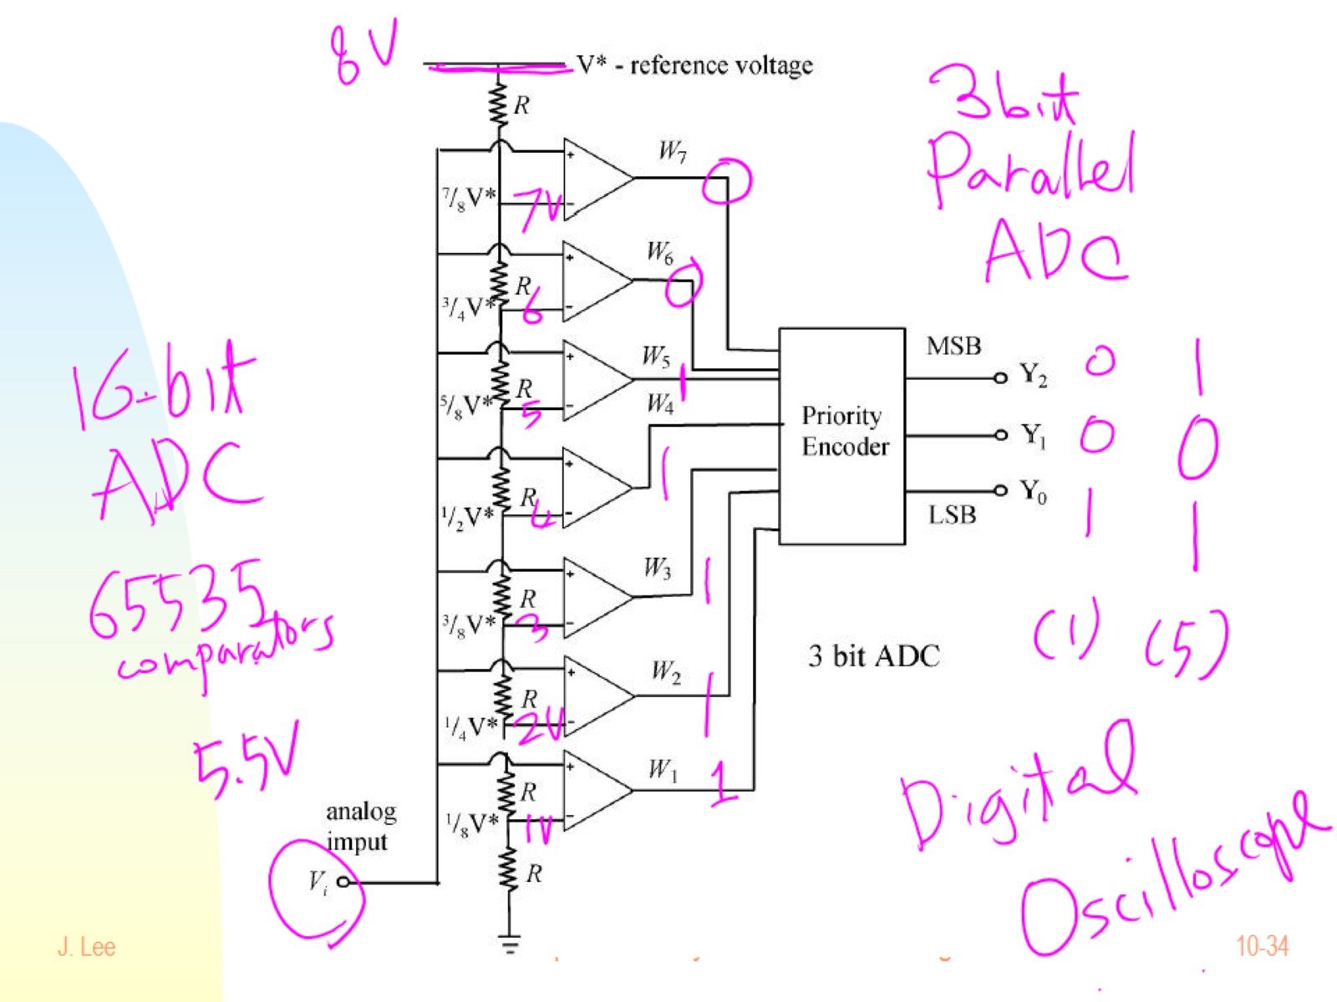

Slide 35
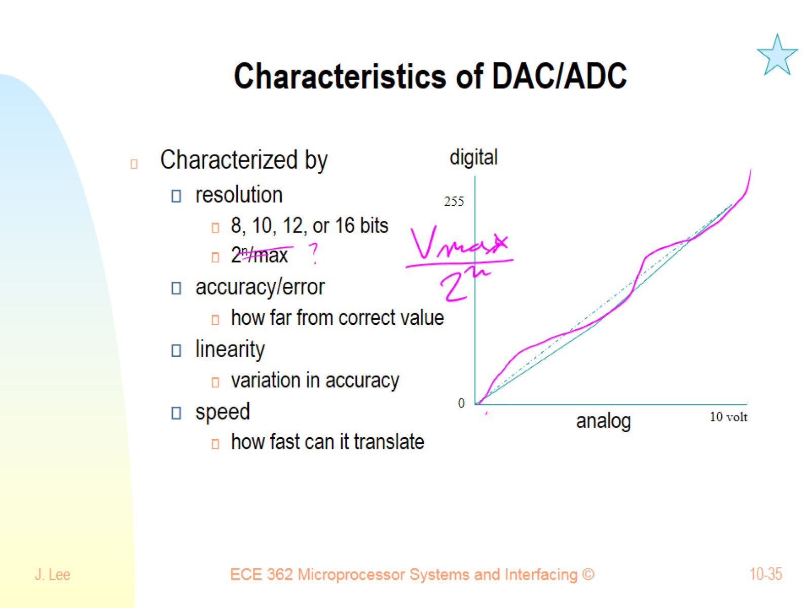
Characteristics of DAC/ADC

Slide 36
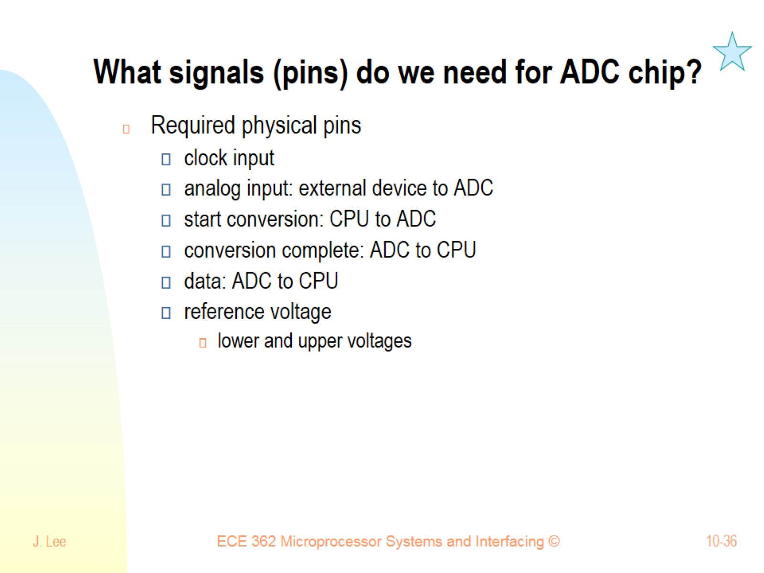
What signals (pins) do we need for ADC chip?

Slide 37
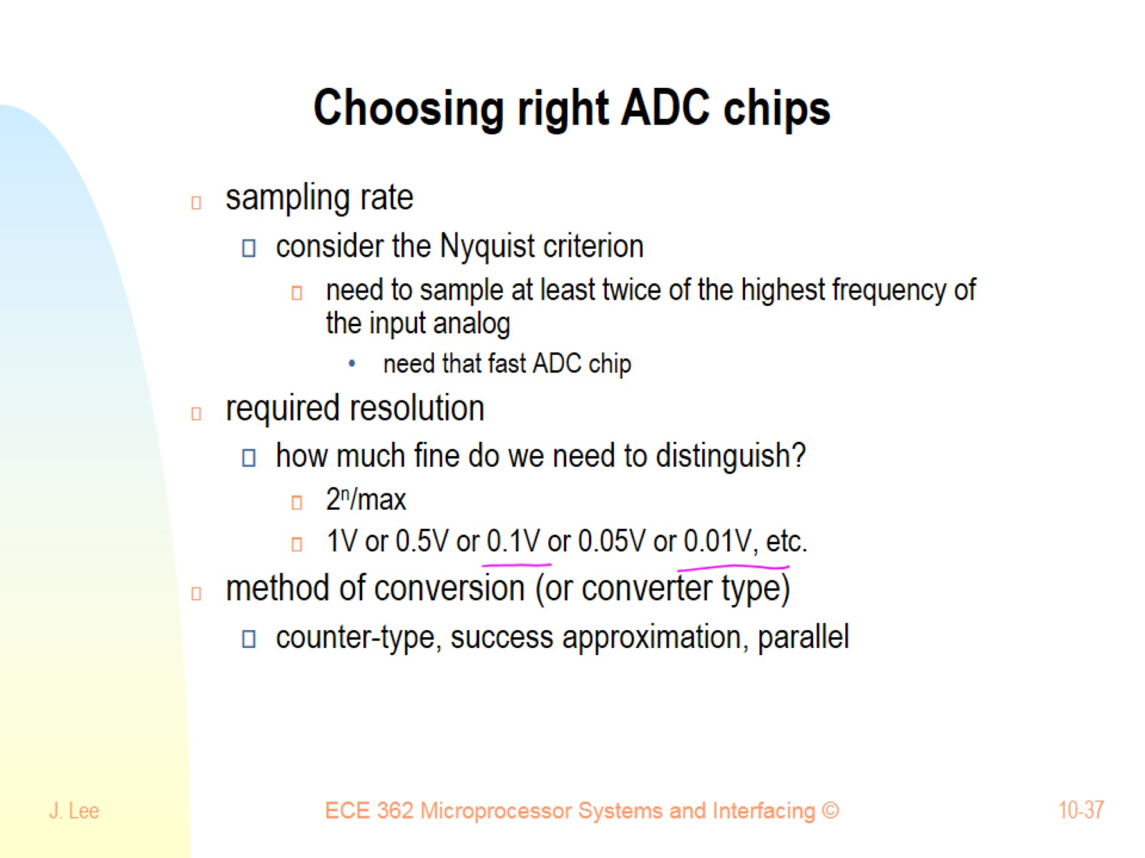
Choosing right ADC chips

Slide 38
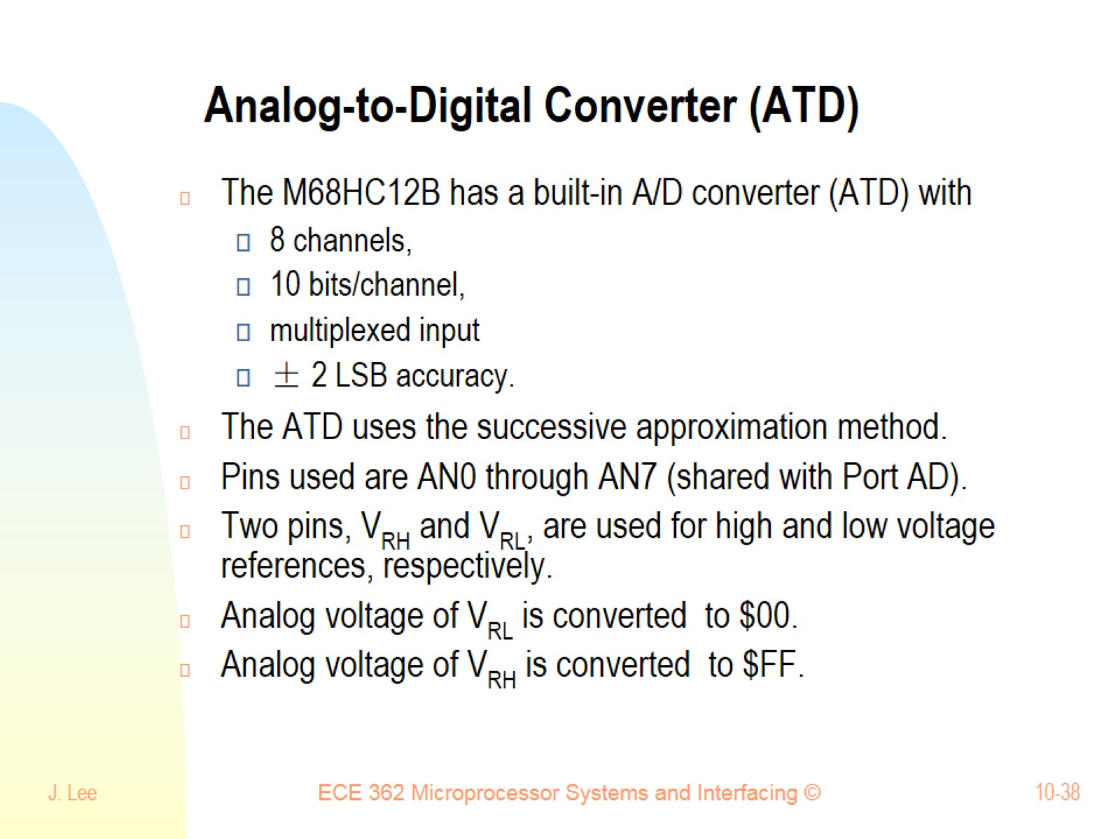
Analog-to-Digital Converter (ATD)

Slide 39
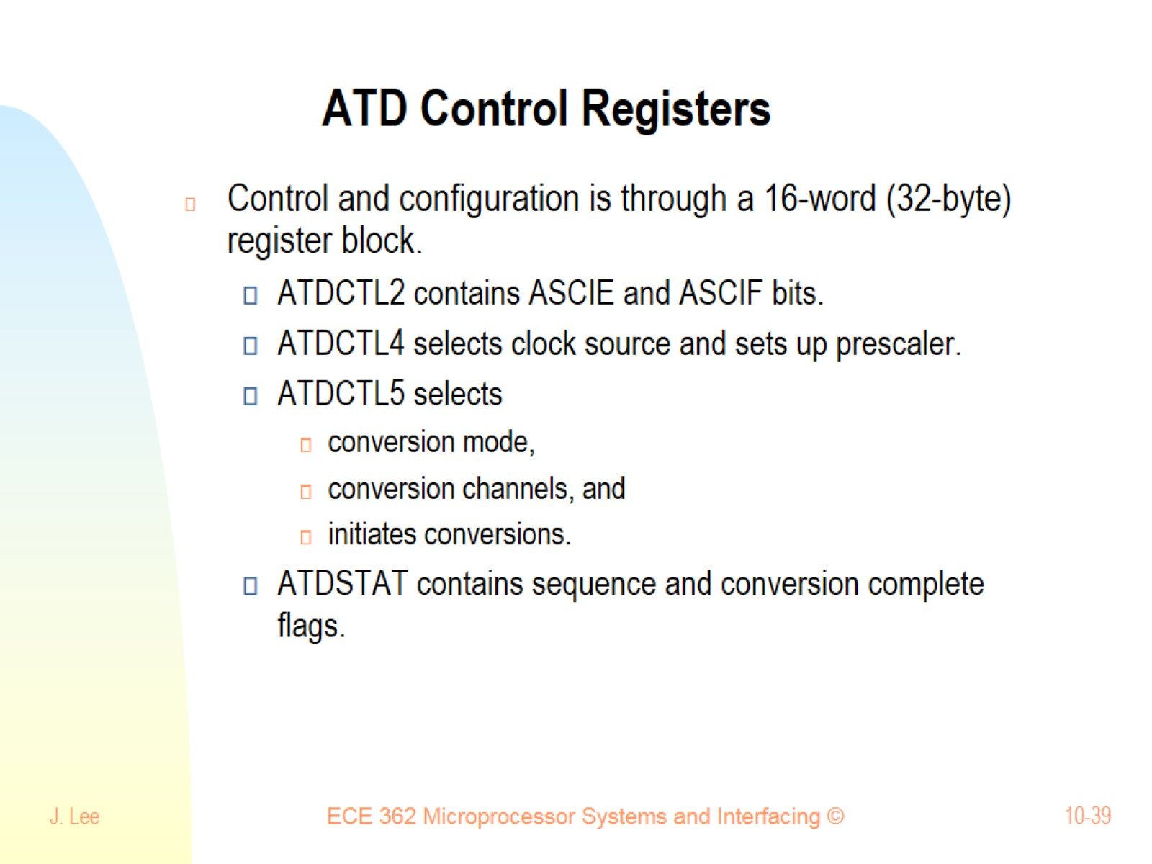
ATD Control Registers

Slide 40
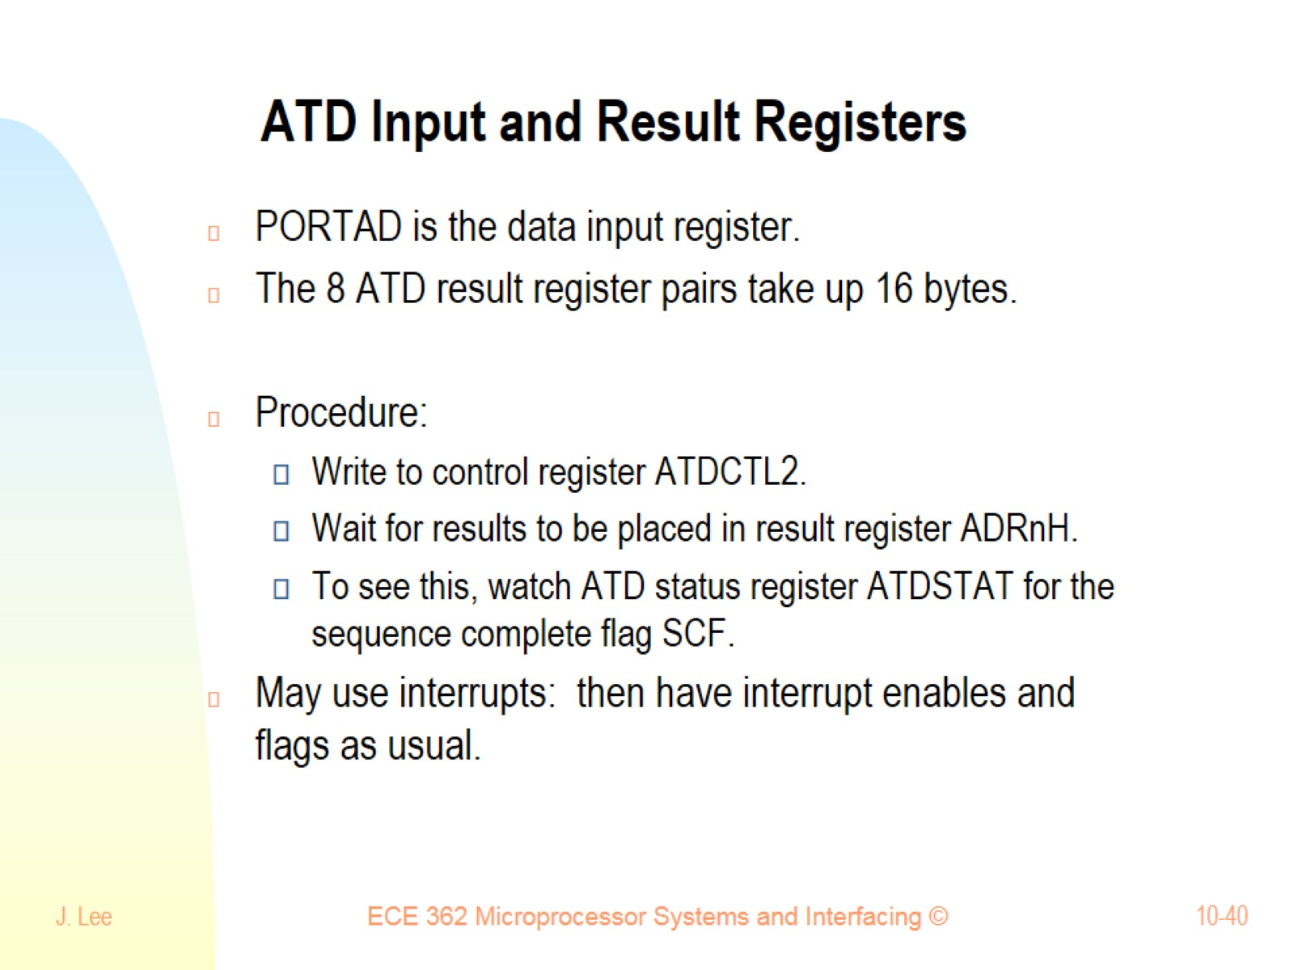
ATD Input and Result Registers

Slide 41
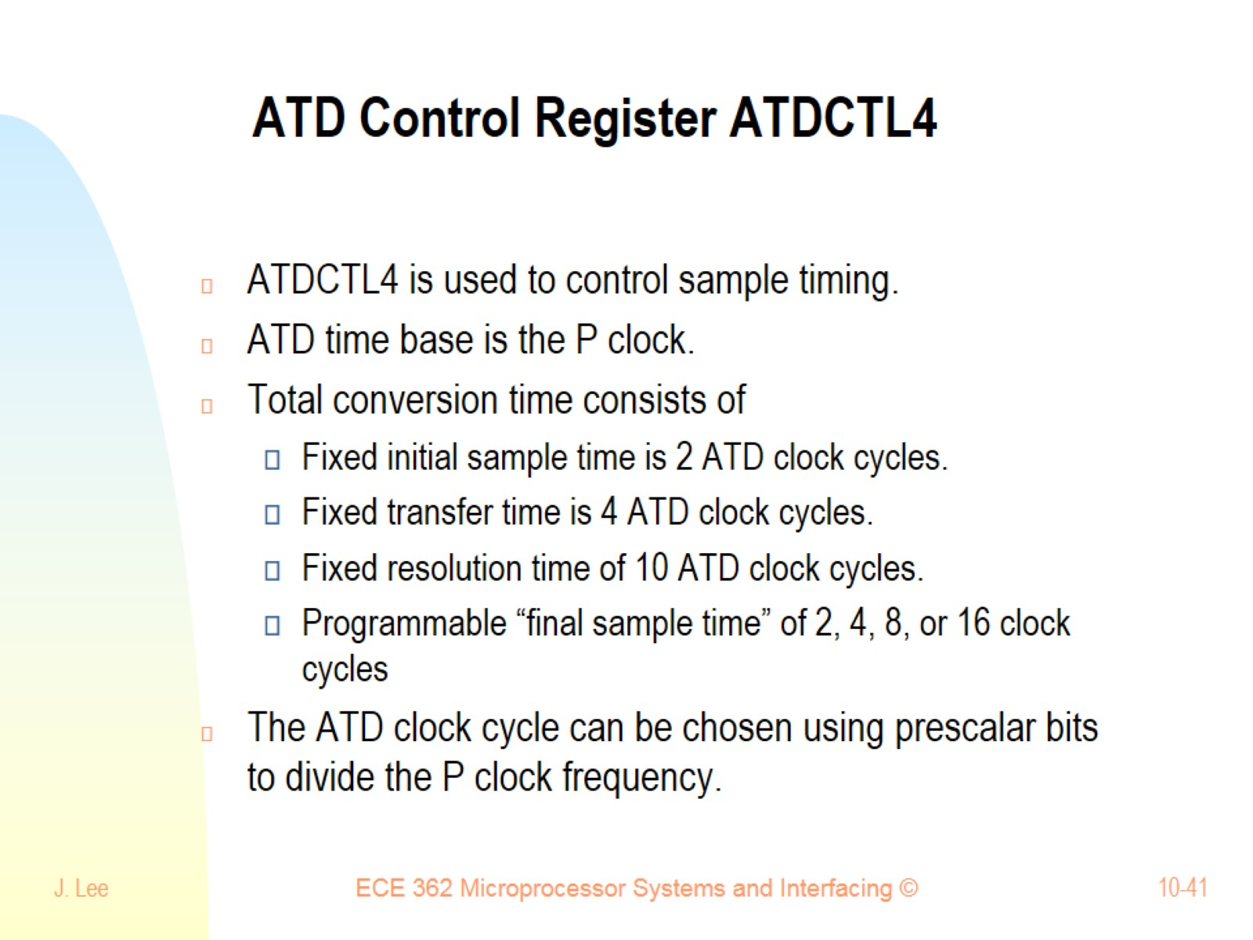
ATD Control Register ATDCTL4

Slide 42
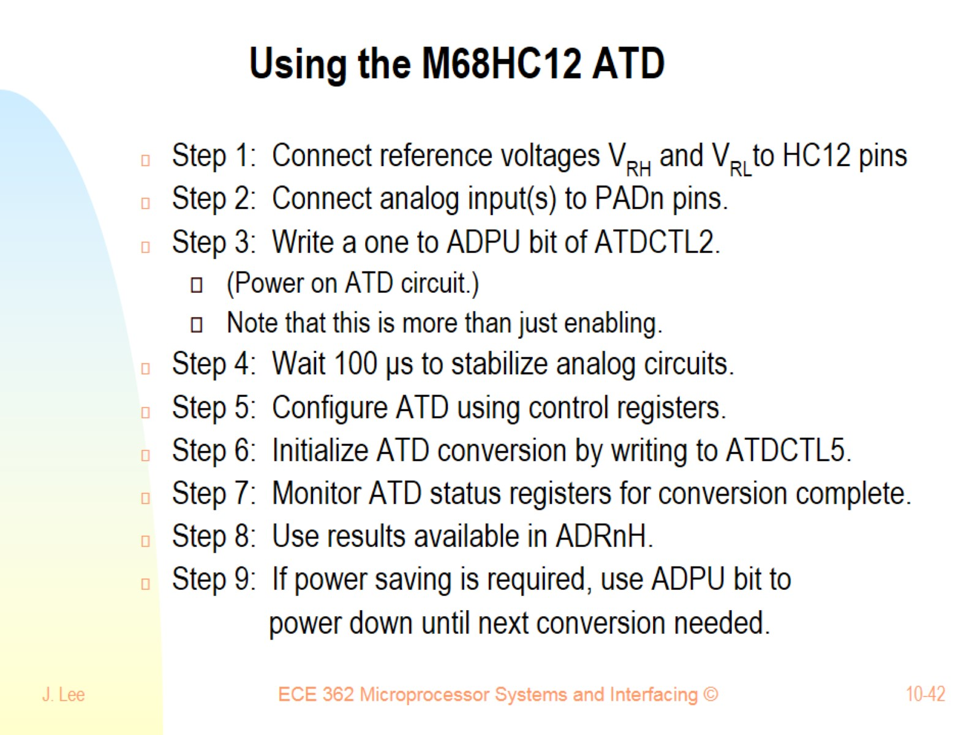
Using the M68HC12 ATD

